Slide 1
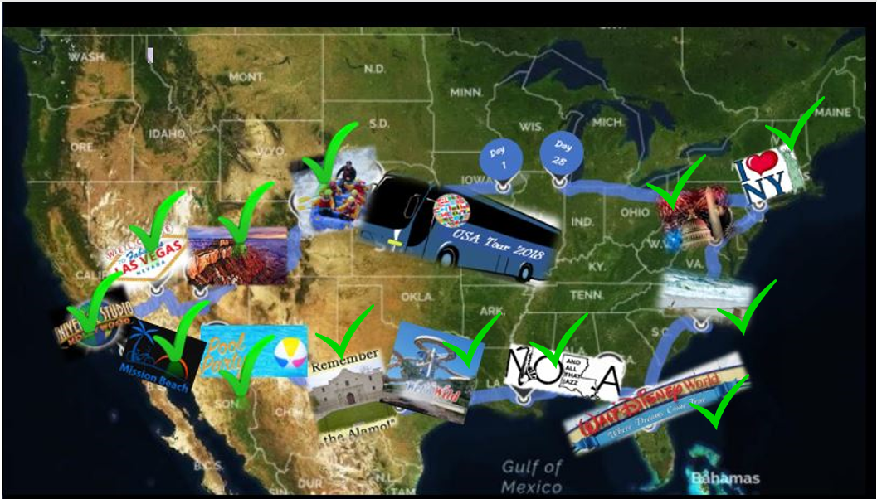
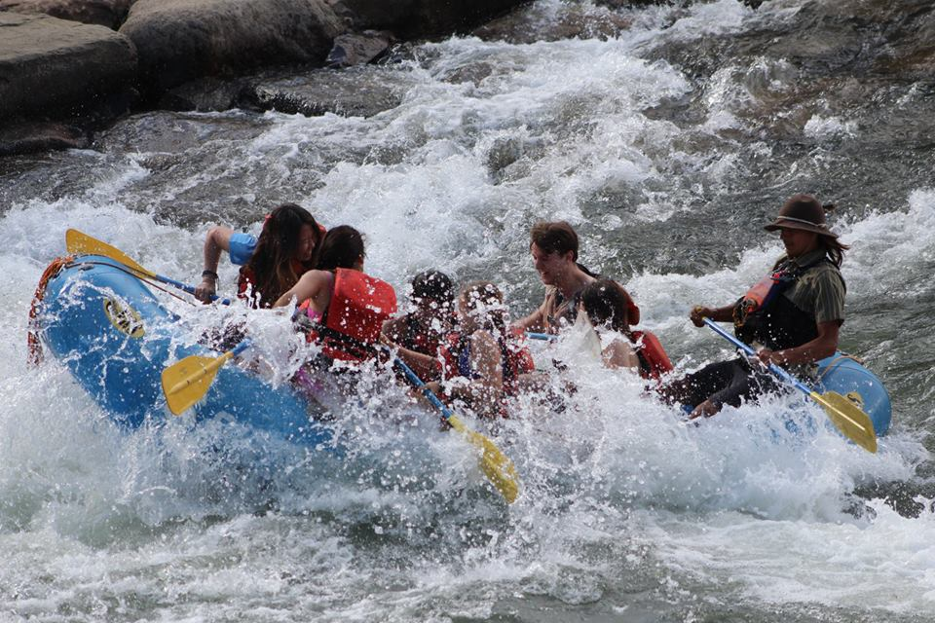
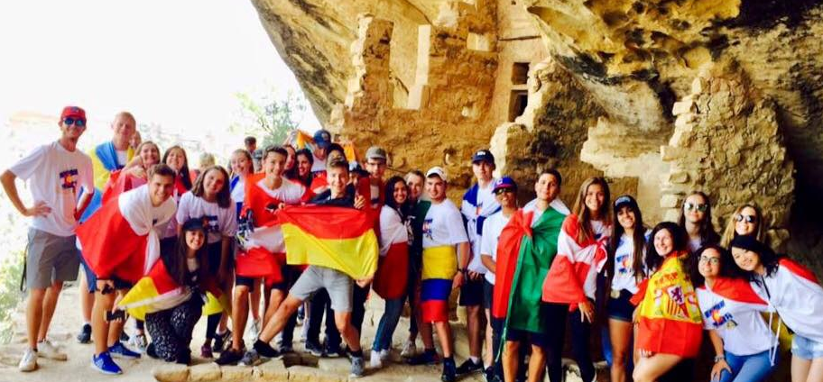
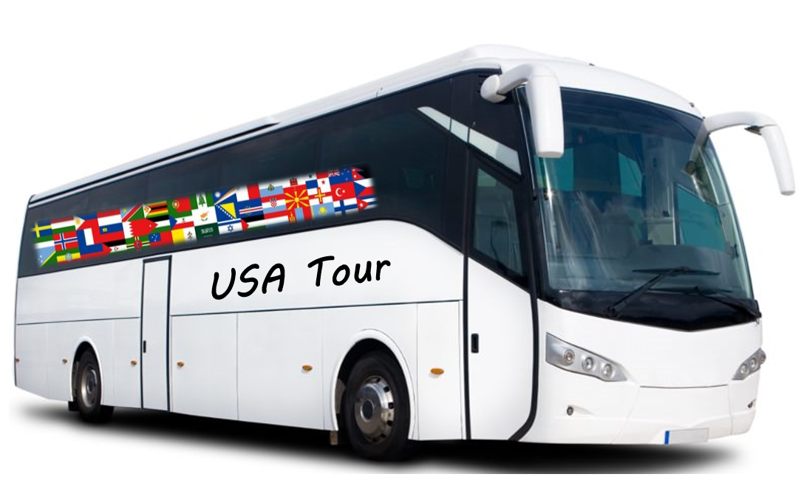
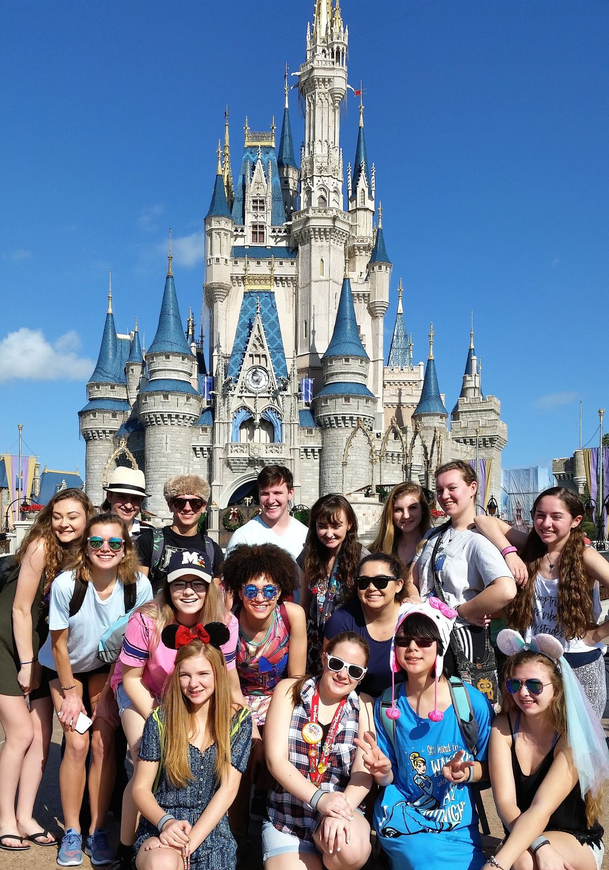
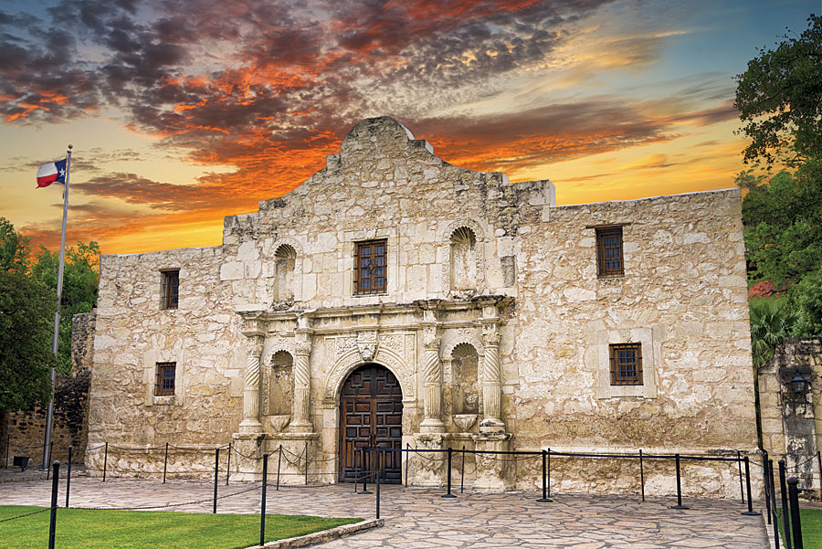
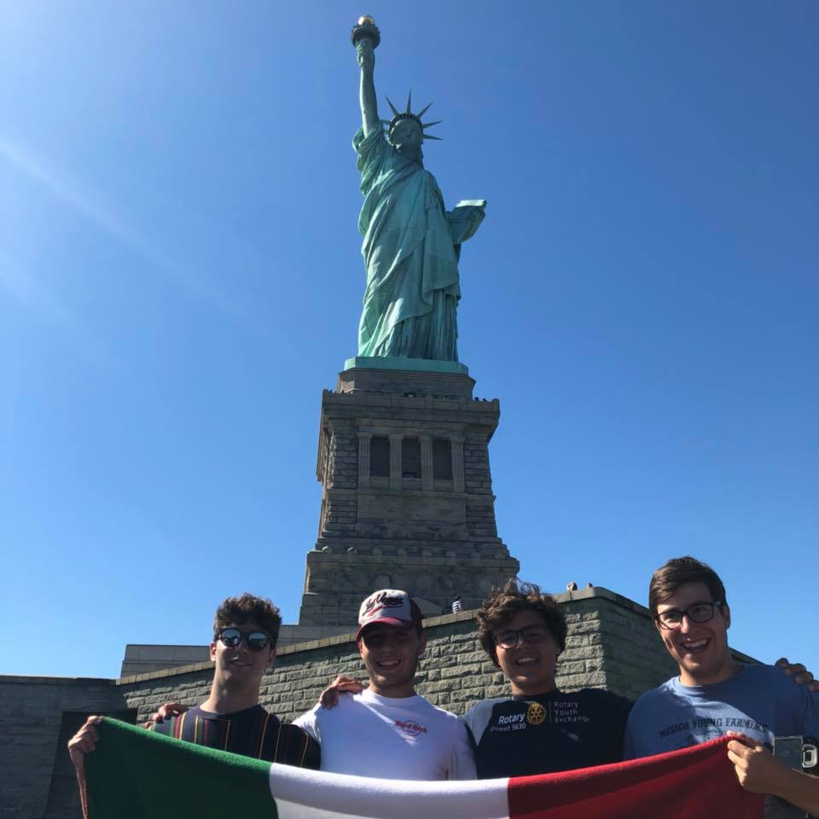
USA Tour 2020

Slide 2
Top Take Aways
Who: Rotary Youth Exchange Long Term Inbounds
What: 28-day Tour of USA (West & East Coast)
When: June 13 – July 10
Why: Cultural Enrichment & End of Exchange Fun
Price: $4,500 (subject to change)

Slide 3
Important Dates
Accept Applications
August 1st
GO/NO GO Decision
December 1st
Deposit Due
December 15th
Final Payment Due
March 1st

Slide 4
Steps to Get Started
1) Complete Application Online Form
3) Collect Signatures (Student, Natural Parents, & YEO)
4) Read & Sign Rules
2) Send Copy of Insurance Card
www.usatours.us

Slide 5
Pickup / Drop Off Locations
Six Pick Up Locations
Coralville/Iowa City, IA, & West Des Moines, IA
Omaha, Grand Island & North Platte, NE
Denver, CO (and Durango CO, if needed)
Five Drop Off Locations
Chicago, IL (O’Hare International Only)
Coralville/Iowa City, IA & West Des Moines, IA
Omaha, NE
www.usatours.us

Slide 6
Money Matters
Included in Tour Price
Charter bus, Hotel Room, Breakfast, Dinner, Admission to all Tour Events
Not Included
Transportation to/from bus location, lunch, laundry stops, personal expenses/souvenirs

Slide 7
Chaperones
3 to 4 Chaperones Per Bus (1:15 ratio)
Volunteer Service (prefer Rotarians)
(all chaperones vetted as Rotarian Youth Volunteer)
Provided: Transportation to/from Bus, Hotels, Breakfast, Dinner, Attractions
Requesting Commitment for full 28 days
Interested?
Please email director@usatours.us

Slide 8
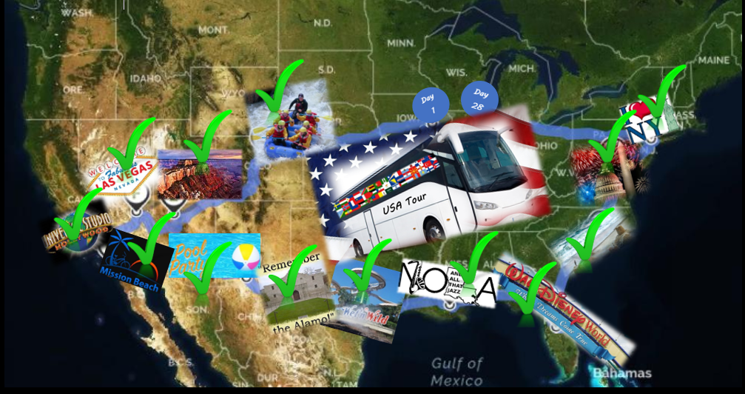
Tour Location Highlights
Notes:
Week 1
Collect Students
General Meeting in Denver
Whitewater Rafting in Durango, CO
Hiking at Mesa Verde National Park, AZ
Grand Canyon and Las Vegas, NV
Round out with Los Angeles and Universal Studios
Week 2
Day at Mission Beach, San Diego, CA
Night doing Laundry
4 Day Trek across Texas
‘The Alamo’ & San Antonio Riverwalk
West Coast Ends in New Orleans, LA
Chaperone Swap
Week 3 & 4
2 Day at Walt Disney World in FL
Drive up the coast, stop at Wilmington Beach in NC
3 Days in Washington, DC over 4th of July Holiday
3 Days in New York City
Statue of Liberty, Times Square
Ramp down trek west to Chicago

Slide 9
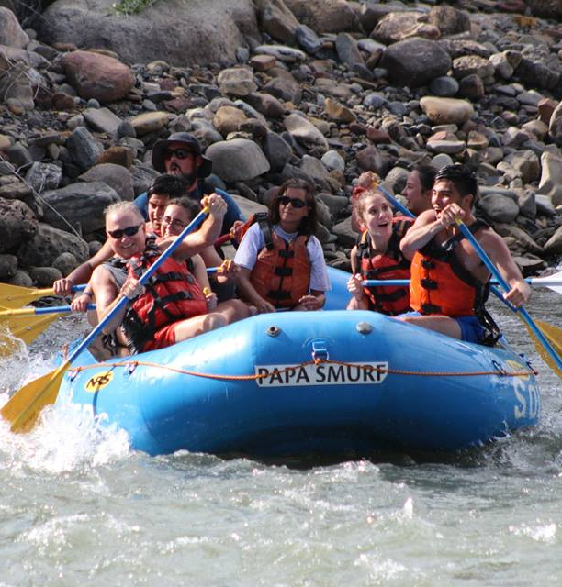
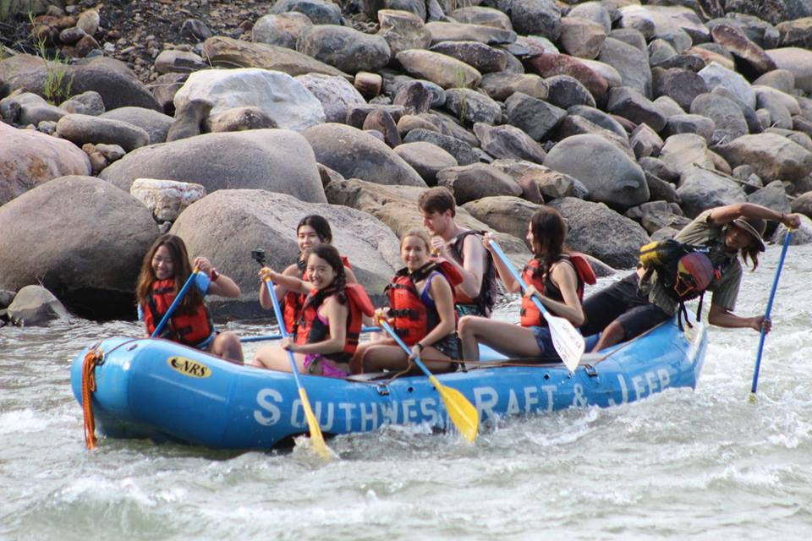
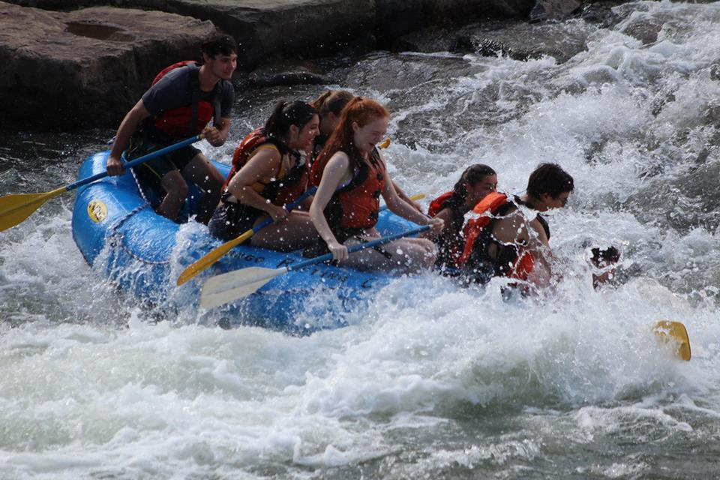
Whitewater Rafting (Durango, CO)

Slide 10
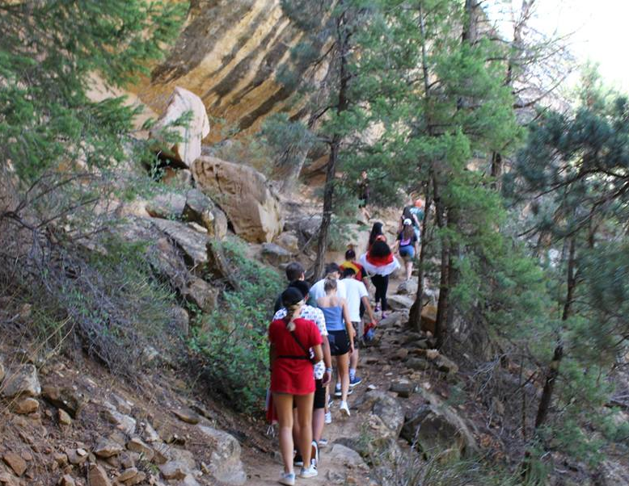
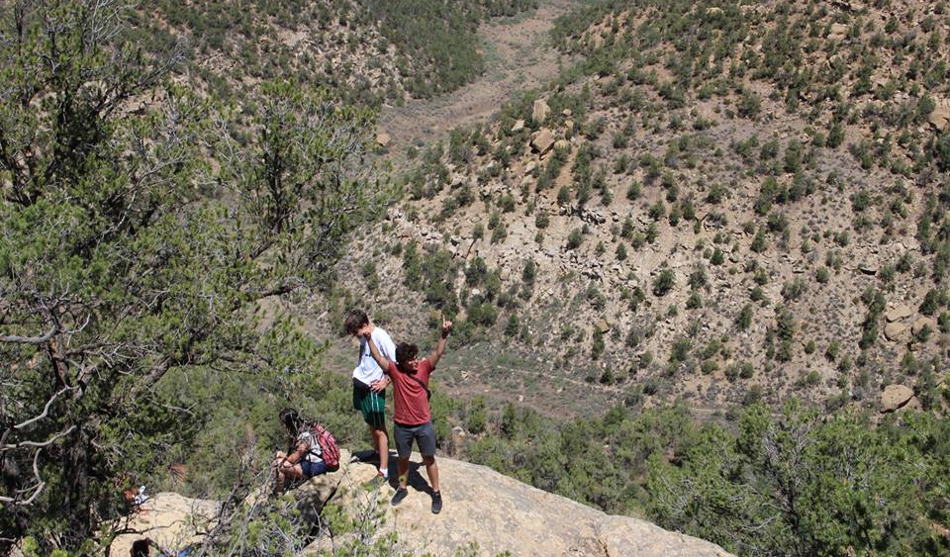
Day Hike at Mesa Verde, CO

Slide 11
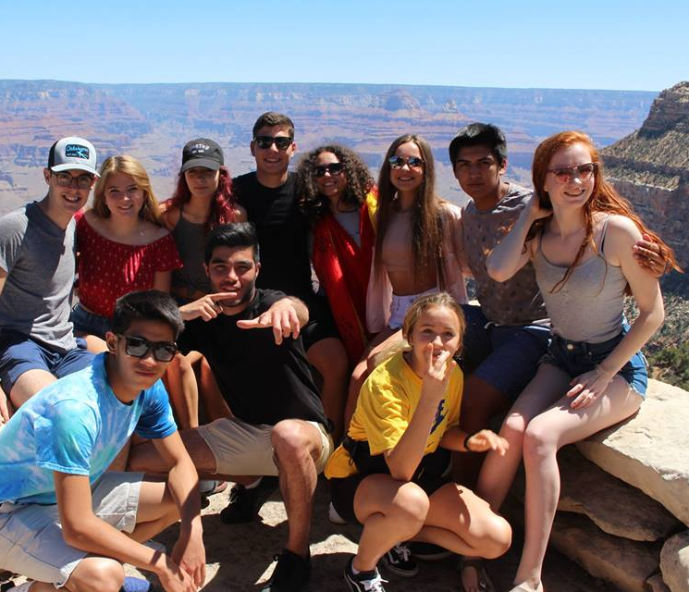
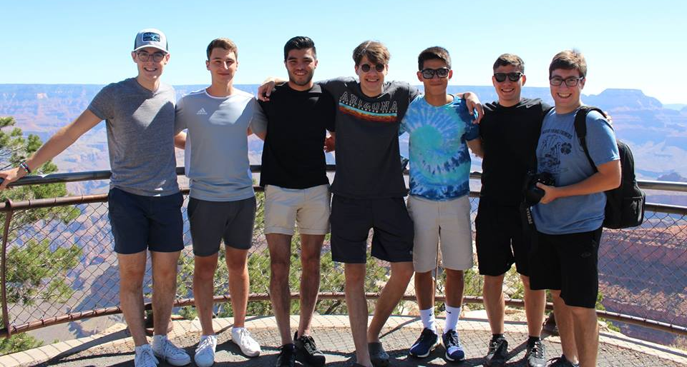
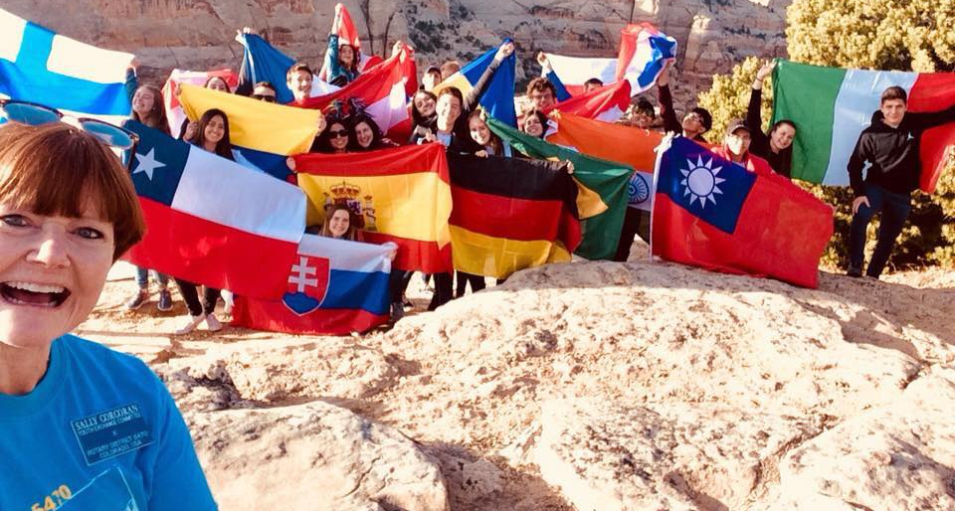
Grand Canyon, AZ
South Rim
7/11/2024

Slide 13
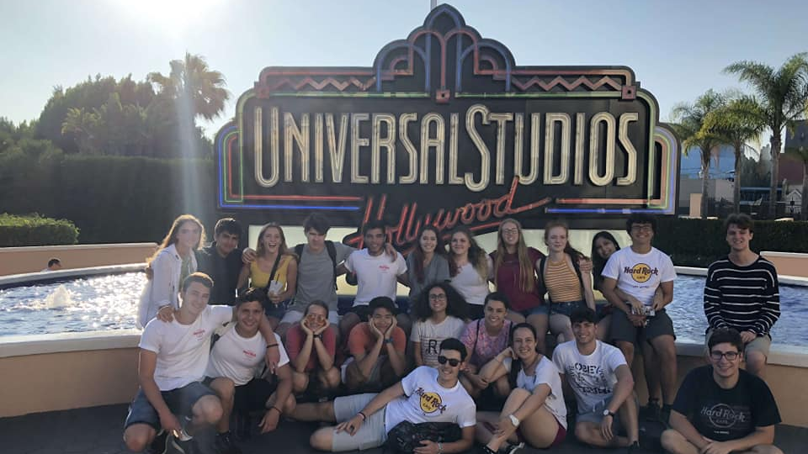

Slide 14
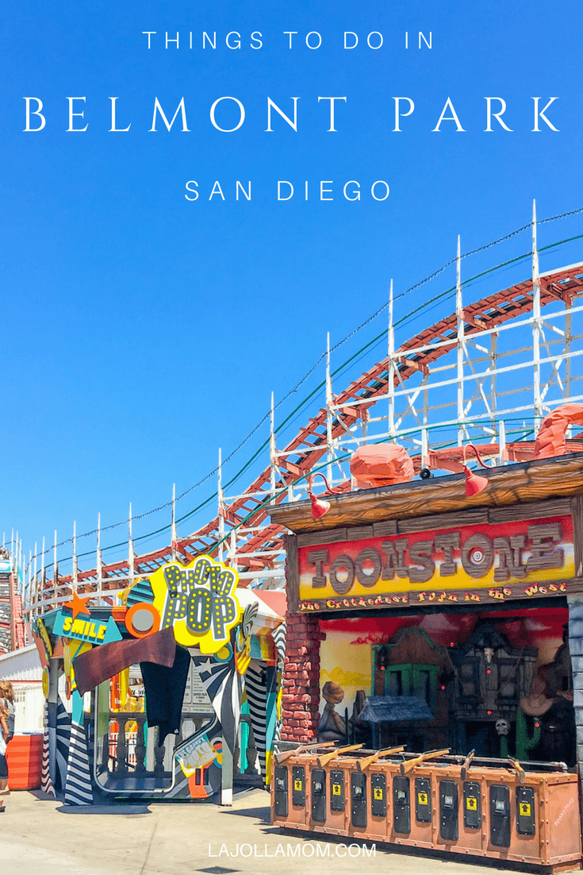
Day at the Beach in Sunny San Diego, CA

Slide 15
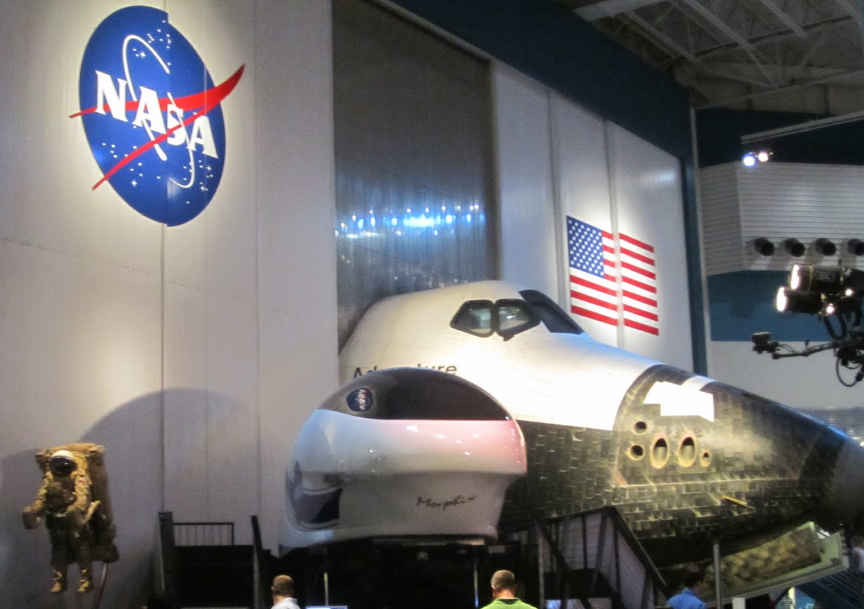
Texas

Slide 16
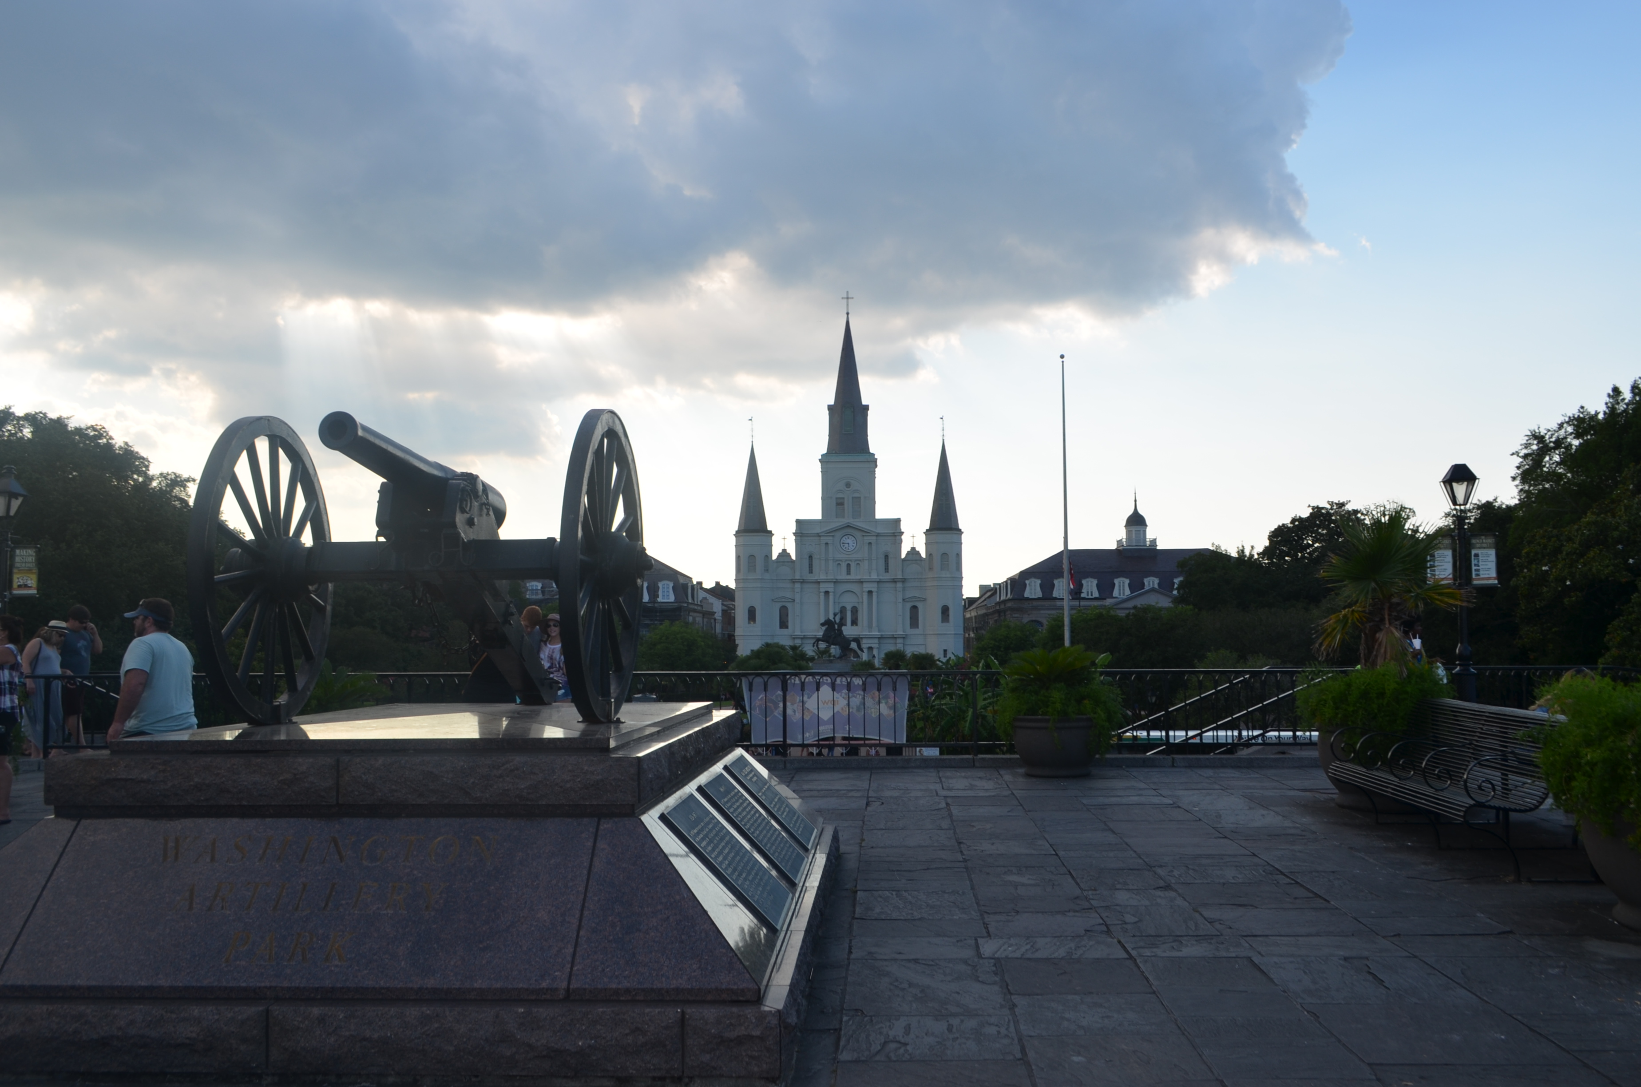
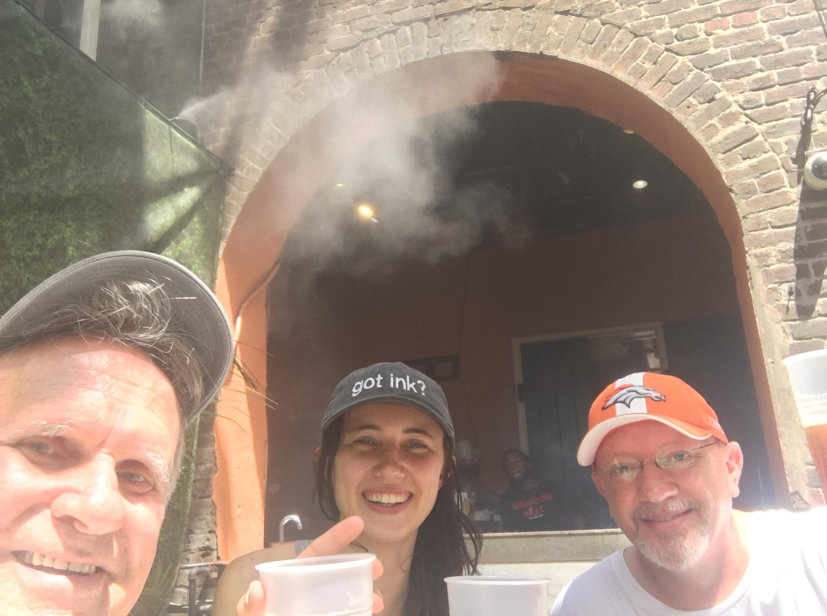
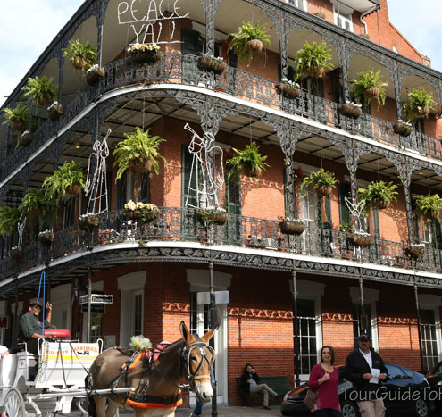
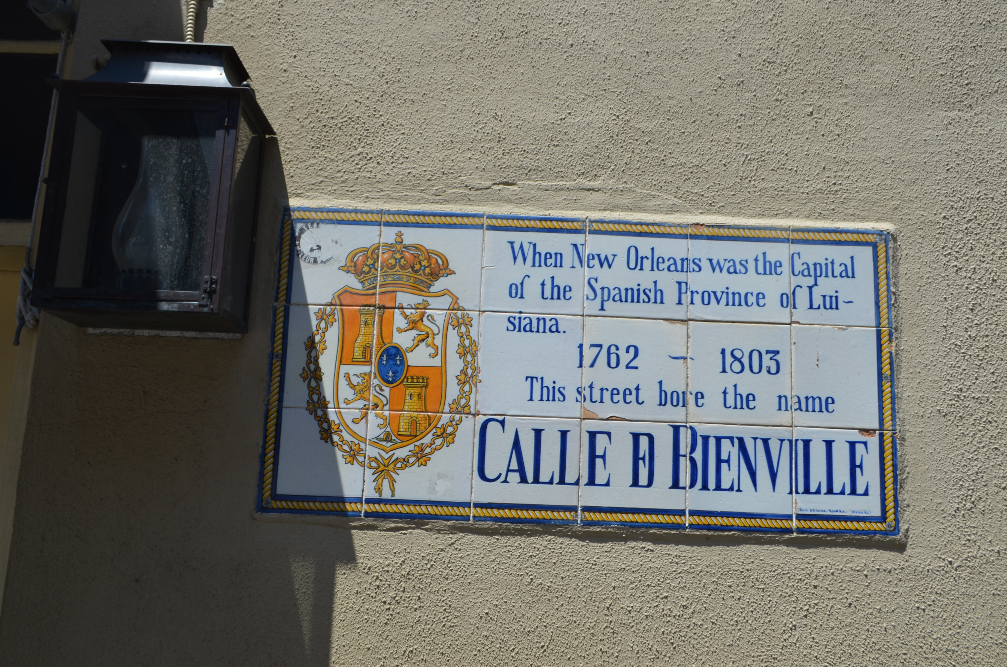

Slide 17
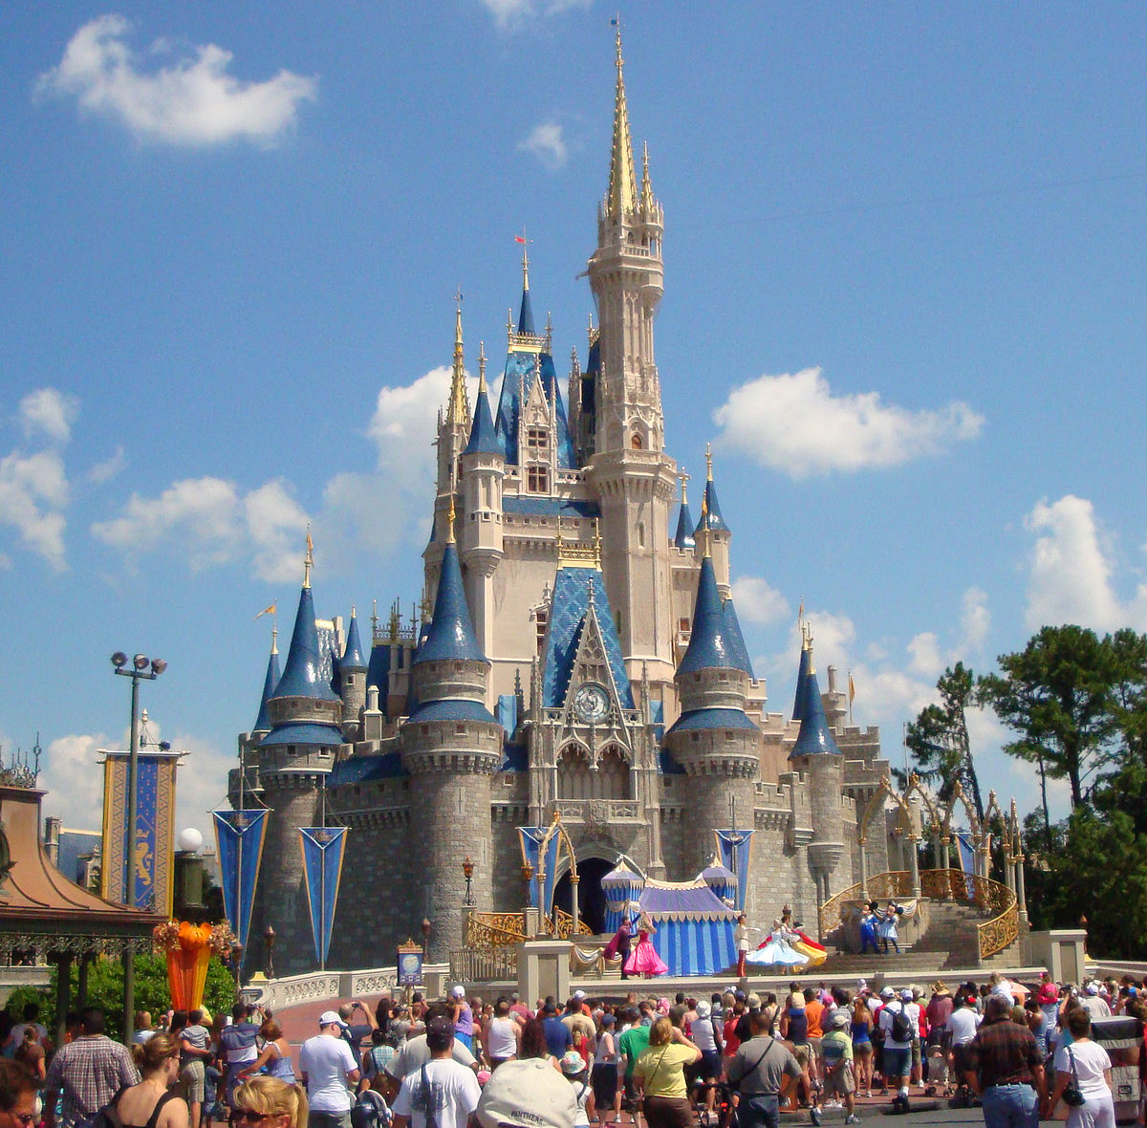
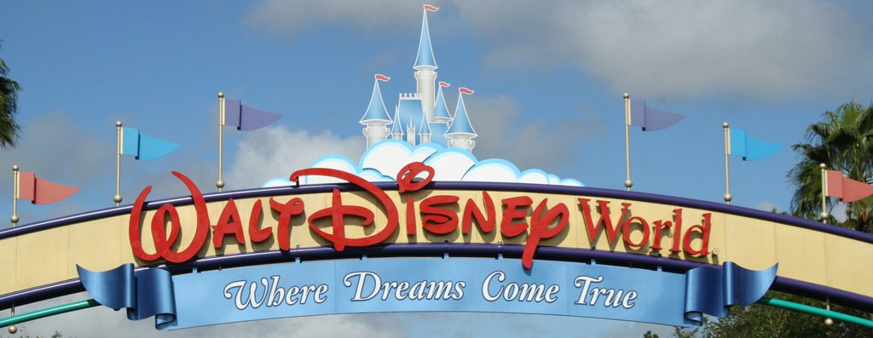

Slide 18
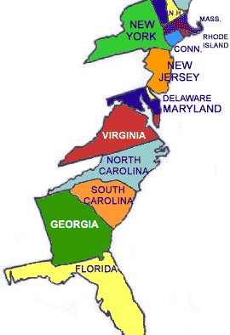
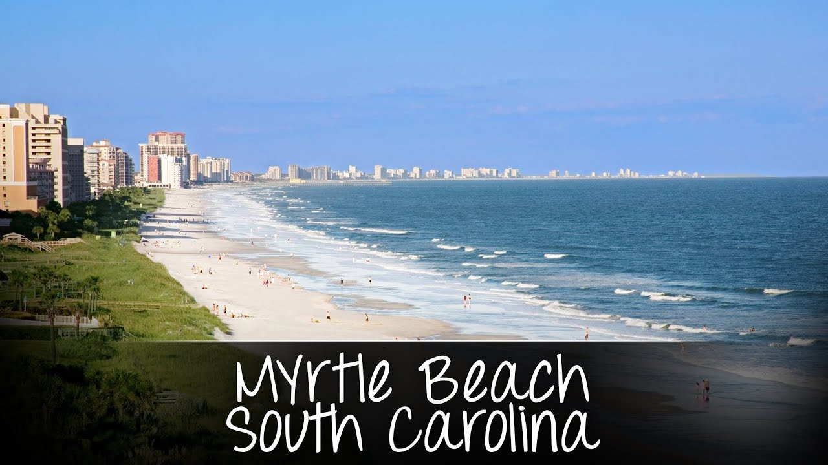
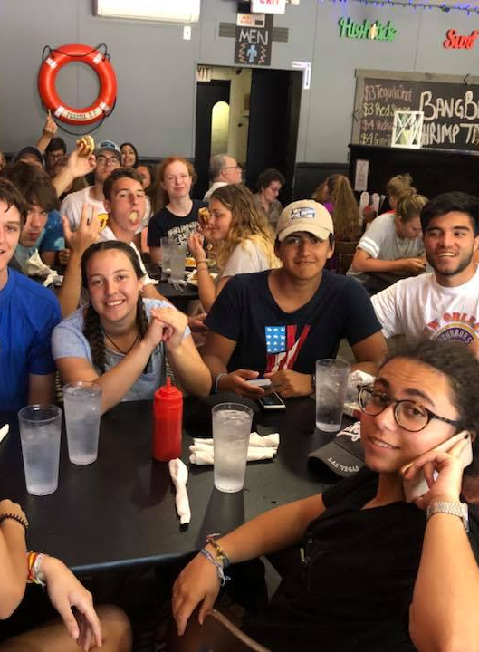
East Coast Sprint to the Fireworks to our Nation’s Capitol!!

Slide 19
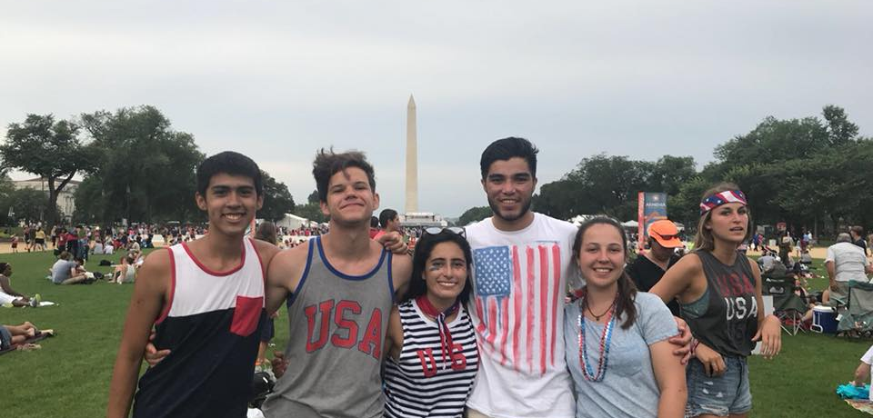
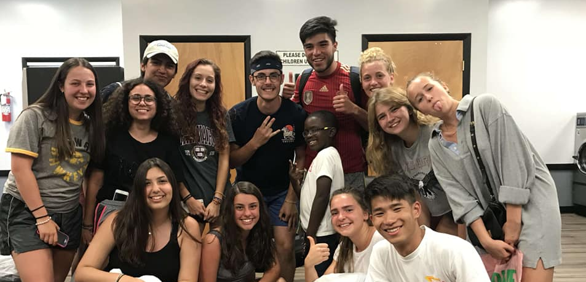
July 4th Holiday in D.C.

Slide 20
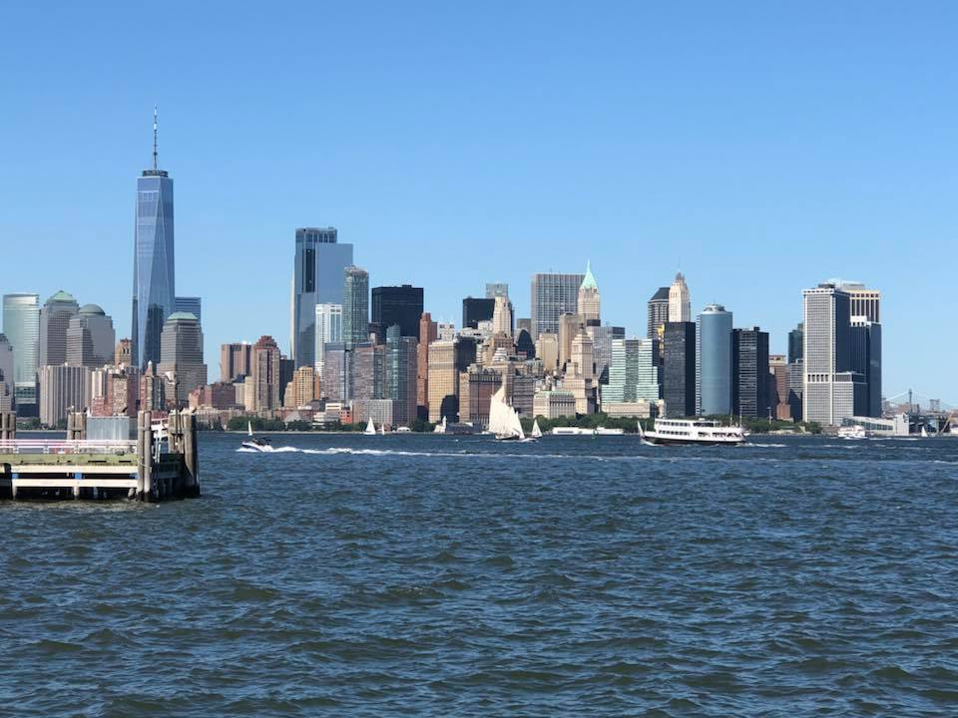
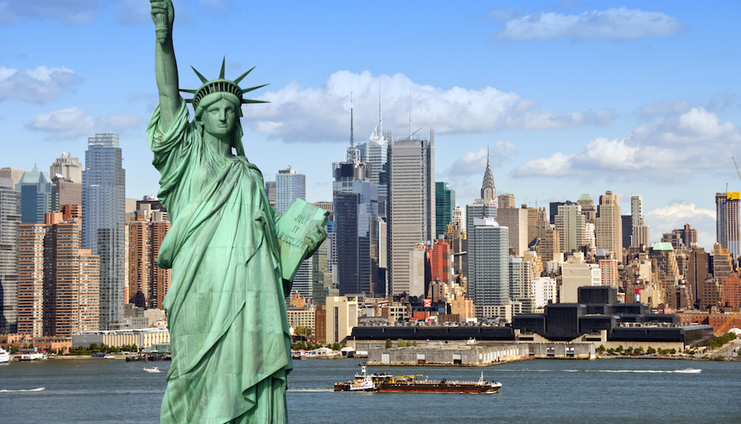

Slide 21
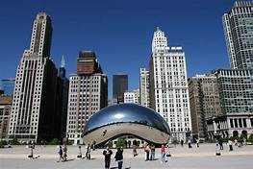
Chicago
End of Tour Celebration

Slide 22
Final Take Away
28 Day Tour
West & East Coasts
Go/No-Go Decision December 1st
Total Cost: $4,500
Deposit due Dec 15th
Balance due March 1st
Tour Dates: June 13 Returns on July 10
www.usatours.us
Notes:
Week 1
Collect Students
General Meeting in Denver
Whitewater Rafting in Durango, CO
Hiking at Mesa Verde National Park, AZ
Grand Canyon and Las Vegas, NV
Round out with Los Angeles and Universal Studios
Week 2
Day at Mission Beach, San Diego, CA
Night doing Laundry
4 Day Trek across Texas
‘The Alamo’ & San Antonio Riverwalk
West Coast Ends in New Orleans, LA
Chaperone Swap
Week 3 & 4
2 Day at Walt Disney World in FL
Drive up the coast, stop at Wilmington Beach in NC
3 Days in Washington, DC over 4th of July Holiday
3 Days in New York City
Statue of Liberty, Times Square
Ramp down trek west to Chicago

Slide 23
CONTACT US
EMAIL: DIRECTOR@USATOURS.US
Rob Ragans cell: 407.376.9900
Sheila Ragans cell: 407.399.8200

