Slide 1

WHAT IS ROTARY?
The world's first service club, the Rotary Club of Chicago, was formed on February 23rd 1905 by Paul P. Harris.
The Rotary name derived from the early practice of rotating meetings among members' offices.
Today, 1.2 million Rotarians belong to over 32,000 Rotary clubs in more than 200 countries and geographical areas.
Motto: Service Above Self
Four Way Test
  Is it the truth?
  Is it fair to all concerned?
  Will it build good will and better friendships?
  Will it be beneficial to all concerned?

Slide 2
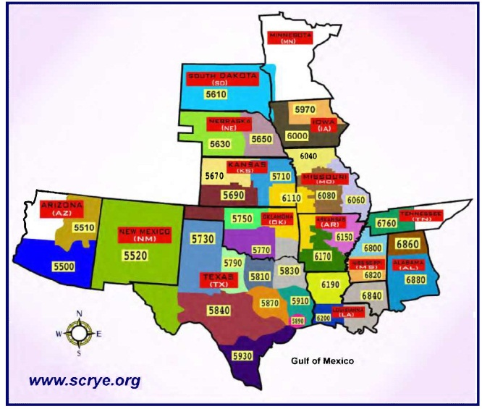
WHAT IS ROTARY
YOUTH EXCHANGE?
Over 75 years old
Over 8,000 students in over 80 countries
Totally Volunteer: Over 1.2 million Rotarians in more than 32,000 clubs
We are Rotary District 5840
Member of South Central
Rotary Youth Exchange, Inc.
(SCRYE) www.scrye.org

Slide 3
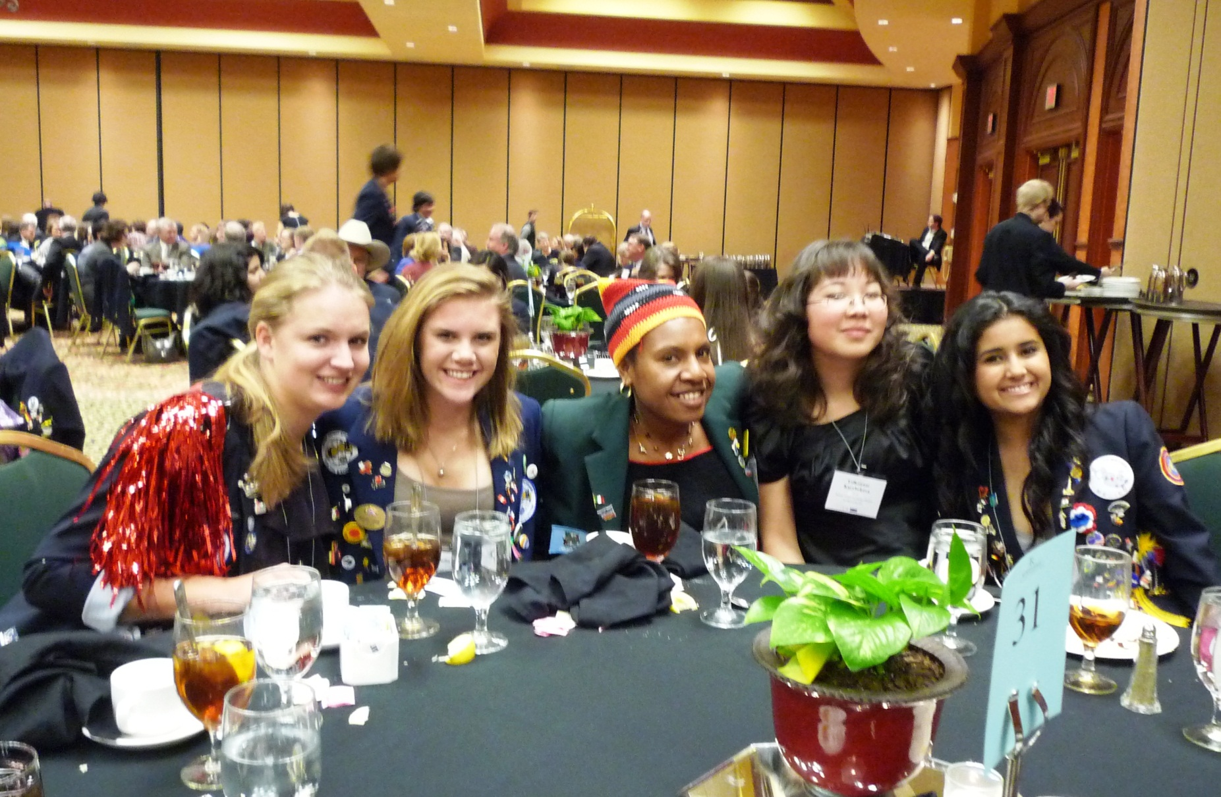
2011 SCRYE Conference in Tulsa

Slide 4

Opening Ceremony at 2011 Rotary International Convention

Slide 5

STUDENT PROTECTION POLICIES
Rotary’s Statement of Conduct for Working with Youth

Slide 6
Statement of Conduct for Working with Youth
Rotary International is committed to creating and maintaining the safest possible environment for all participants in Rotary activities. It is the duty of all Rotarians, Rotarians’ spouses, partners, and other volunteers to safeguard to the best of their ability the welfare of and to prevent the physical, sexual, or emotional abuse of children and young people with whom they come into contact.

Slide 7
STUDENT PROTECTION POLICIES
Rotary’s Statement of Conduct for Working with Youth
District 5840 Crisis Management Plan

Slide 8

CRISIS MANAGEMENT PLAN
What is a Crisis?
Crisis Management Chair is Youth Protection Officer (YPO)
Timely, Accurate, Concise – it’ critical!
If you witness or are notified of a crisis, contact medical authorities then YPO
Do NOT contact natural parents or media
District Youth Exchange Officer (YEO) will contact sponsor YEO who will contact natural parents
Media Spokesperson is the only person to talk to the media
Follow the Law!

Slide 9
STUDENT PROTECTION POLICIES
Rotary’s Statement of Conduct for Working with Youth
District 5840 Crisis Management Plan
District 5840 Sexual Abuse Reporting Guidelines

Slide 10
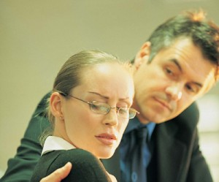
SEXUAL ABUSE
REPORTING GUIDELINES
Listen attentively and stay calm
Protect the student / Remove Student
Get the facts, but don’t interrogate
Be non-judgmental and reassure the student
Assure privacy but not confidentiality
Record Everything
Report Abuse immediately to the Club Counselor and the appropriate the YPO
Avoid gossip and blame
Do not challenge the alleged offender
Follow-Up

Slide 11
STUDENT PROTECTION POLICIES
Rotary’s Statement of Conduct for Working with Youth
District 5840 Crisis Management Plan
District 5840 Sexual Abuse Reporting Guidelines
Chain of Command

Slide 12

CHAIN OF COMMAND
District
Governor
Dist RYE
Committee
District
YEO
Sponsor
YEO
Club Counselor/LC
Host Family
STUDENT
Club
Notes:
I am the Youth Exchange Officer for 2010-11
Also known as the Youth Exchange Chairman
DG is the head of the program with final say on all matters
South Central Rotary Youth Exchange Multi-District

Slide 13
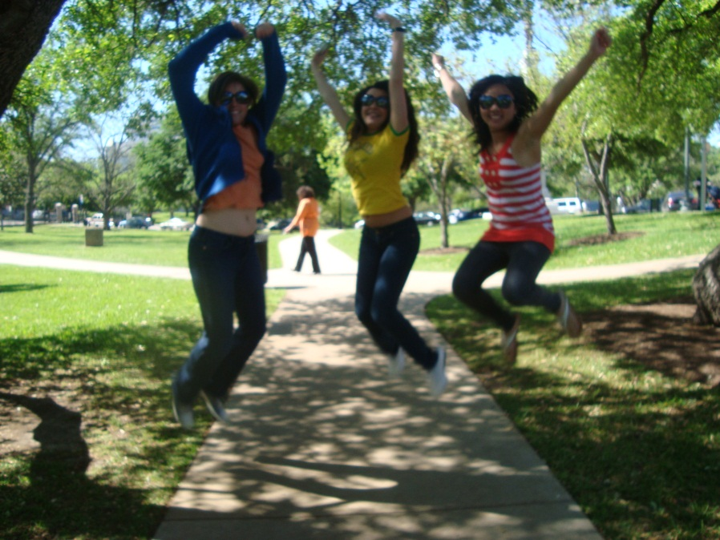
THE DO’S
At least two Host Families (three is best)
High School
Club Member
Member of the Family
UIL eligibility
Health Insurance
HAVE FUN!
Notes:
Have to have Two Host Families, Preferably Three
Student must attend High School (J1 Visa)
Determine what High School he/she will attend
Need to select a Counselor (same sex is preferable)
Make the student a member of your club (badge)
Get application completed so we can send to the student for VISA
UIL eligible if they have not graduated from their home country
They come with health insurance already purchased
They may bring credit card, debit card, traverlers checks, cell phone, computer, ipod, etc.

Slide 14
District 5840 Is a
Non-Smoking District!

Slide 15
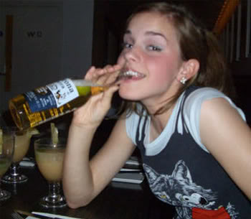
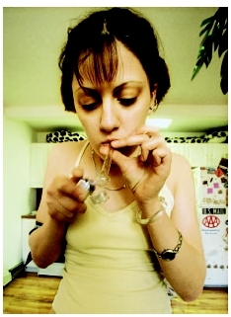
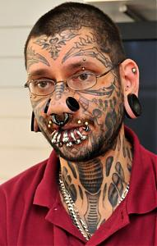



DON’T FOR STUDENTS
(Six D’s)
Drinking
Drugs
DEFACING
Downloading
Dating
Driving
Notes:
Don’t engage in rough physical play including horseplay
Don’t use physical force in any way, especially as form of punishment
Don’t touch in a way that may be interpreted as intrusive or sexual
Don’t make sexually suggestive comments or jokes
Don’t spend excessive time alone with the student. It may be misleading
Student may not leave the country during the exchange.
Student may not visit family or friends during exchange
No vacations unless approved by Youth Exchange Committee
Six D’s
No Drinking
No Drugs
No Dating
No Driving
No Defacing Body (come back the way they came)
No Downloading Porn

Slide 16

DON’TS FOR
ADULTS
Improper physical contact
Notes:
Don’t engage in rough physical play including horseplay
Don’t use physical force in any way, especially as form of punishment
Don’t touch in a way that may be interpreted as intrusive or sexual
Don’t make sexually suggestive comments or jokes
Don’t spend excessive time alone with the student. It may be misleading
Student may not leave the country during the exchange.
Student may not visit family or friends during exchange
No vacations unless approved by Youth Exchange Committee
Six D’s
No Drinking
No Drugs
No Dating
No Driving
No Defacing Body (come back the way they came)
No Downloading Porn

Slide 17

DON’TS FOR
ADULTS
Improper physical contact
Verbal Abuse
Notes:
Don’t engage in rough physical play including horseplay
Don’t use physical force in any way, especially as form of punishment
Don’t touch in a way that may be interpreted as intrusive or sexual
Don’t make sexually suggestive comments or jokes
Don’t spend excessive time alone with the student. It may be misleading
Student may not leave the country during the exchange.
Student may not visit family or friends during exchange
No vacations unless approved by Youth Exchange Committee
Six D’s
No Drinking
No Drugs
No Dating
No Driving
No Defacing Body (come back the way they came)
No Downloading Porn

Slide 18
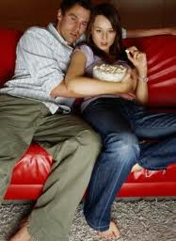
DON’TS FOR
ADULTS
Improper physical contact
Verbal Abuse
Misleading Environment
Notes:
Don’t engage in rough physical play including horseplay
Don’t use physical force in any way, especially as form of punishment
Don’t touch in a way that may be interpreted as intrusive or sexual
Don’t make sexually suggestive comments or jokes
Don’t spend excessive time alone with the student. It may be misleading
Student may not leave the country during the exchange.
Student may not visit family or friends during exchange
No vacations unless approved by Youth Exchange Committee
Six D’s
No Drinking
No Drugs
No Dating
No Driving
No Defacing Body (come back the way they came)
No Downloading Porn

Slide 19
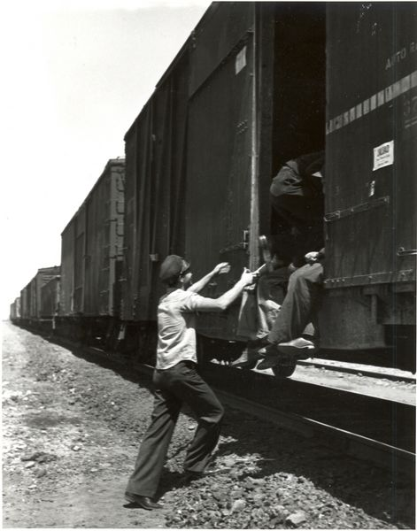
DON’TS FOR
ADULTS
Improper physical contact
Verbal Abuse
Misleading Environment
UnApproved Travel
Notes:
Don’t engage in rough physical play including horseplay
Don’t use physical force in any way, especially as form of punishment
Don’t touch in a way that may be interpreted as intrusive or sexual
Don’t make sexually suggestive comments or jokes
Don’t spend excessive time alone with the student. It may be misleading
Student may not leave the country during the exchange.
Student may not visit family or friends during exchange
No vacations unless approved by Youth Exchange Committee
Six D’s
No Drinking
No Drugs
No Dating
No Driving
No Defacing Body (come back the way they came)
No Downloading Porn

Slide 20
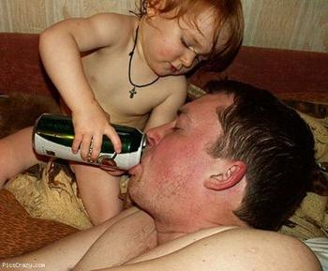
DON’TS FOR
ADULTS
Improper physical contact
Verbal Abuse
Misleading Environment
UnApproved Travel
Encouraging the Six D’s
Notes:
Don’t engage in rough physical play including horseplay
Don’t use physical force in any way, especially as form of punishment
Don’t touch in a way that may be interpreted as intrusive or sexual
Don’t make sexually suggestive comments or jokes
Don’t spend excessive time alone with the student. It may be misleading
Student may not leave the country during the exchange.
Student may not visit family or friends during exchange
No vacations unless approved by Youth Exchange Committee
Six D’s
No Drinking
No Drugs
No Dating
No Driving
No Defacing Body (come back the way they came)
No Downloading Porn

Slide 21
Rotary International District 5840 Youth Exchange Committee

Slide 22
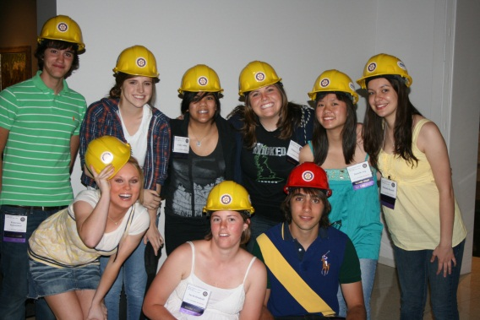
DUTIES OF THE DISTRICT
Provide Training For District Committee and Clubs
Furnish Criminal Background Checks (CBCs) for: District Volunteers, Club Volunteers and Host Families (District YEC will now absorb cost of CBCs)
Inbound Orientation (September 13-15 Other Place NB)
Outbound Interviews (November 16)
Orientations for Outbounds (including Inbounds) -- January 5; February 28-March 2; June 8
SCRYE Winter Conference (January 24-26)
District Conference in San Antonio (Omni) (May 2-4 )
RYLA (17-19)
SCRYE Approved Tours (June)
Leaving for home (June or July)
Notes:
Arrival around mid-August
Bring a small gift from the club

Slide 23
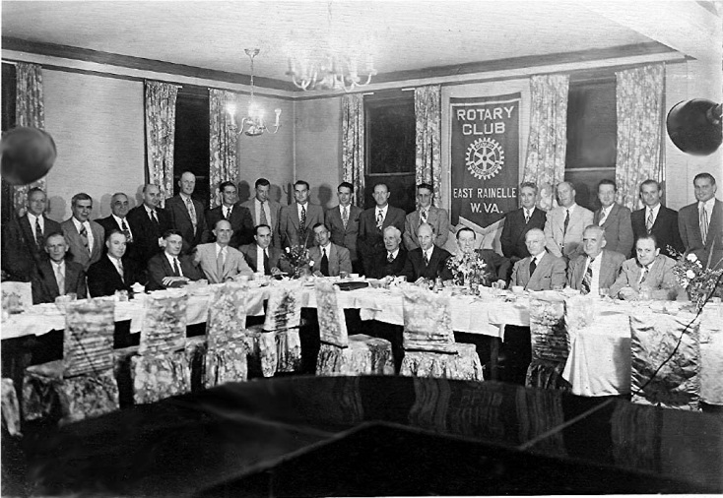
DUTIES OF THE CLUB
Host Club Guarantees Placement
At least 2 Host Families
Help with Transportation
Welcome as a member of
the club (badge)
All members participate
Let student give presentations
Welcome Party
Going Home Party
Notes:
Host Club guarantees to provide a caring environment, personal support and counseling to the student during the duration of the exchange
Every student comes back more knowledgeable and more responsible
District Activities take a priority
Host families do not have to be Rotarians
Help with transportation to special events
Host Families, Counselors and anyone spending considerable time or keeping the student overnight must have a CBC done
In case of emergency, contact Counselor. Counselor will contact YEO.
In extreme cases, Counselor will contact me and the Club President, then I will contact District Media Crisis Spokesperson
In case of major accident or death, nobody should speak about the problem except the District Media Crisis Spokesperson. I will contact the YEO of the Sponsoring club who will contact the parents.

Slide 24

DUTIES OF THE COUNSELOR
Student Representative
Connect with student
Host upon arrival
Accompany to Orientation
In-Home Interviews
First Night Questions
Host Family Orientations
Moving Student
Weekly Log
Texas ID
Emergency Money
Check www.scrye.org
Notes:
Represents the student and has the student’s best interest in mind
Provide an eat to listen, a shoulder to cry on & a hand to depend on
Connect with the student and his/her parents before arrival
Host the student upon arrival until after orientation
Inbound Camp & Orientation (August 13-16 at Prude Ranch)
In-Home Interviews and First Night Questions
Assist in Host Family Orientation
Move the students from one house to the next. Easier for student
Fax or email weekly log of contact with your student
Get him/her a Texas ID
Hold on to original passport, return plane ticket and emergency money ($400)
Remember: It is the student’s responsibility to adapt!

Slide 25

DUTIES OF A HOST PARENT
Room and Board
Be parents: love, support, encouragement, understanding, discipline
Treat student like your own child
Clearly communicate your family
expectations to student (First Night Questions)
Help with challenges
Transportation
Healthy Boundaries
  Internet Policy
  Cell Phone Policy
  Curfew
  Dress Code
  Talking to Home

Slide 26

DUTIES OF THE STUDENT
Communicate
Health Insurance
Adapt to host family
Learn language and culture
Perform well in school
Represent country and Rotary
Participate in Rotary, school, and community activities
No jobs except for occasional baby-sitting or yard work
Keep Track of Passport, visa and I-94
Return airline ticket

Slide 27

INSURANCE
Students have their own insurance
Health issues should not be a burden to Host Families, Counselor or others
Student, Host Families and
Counselor should keep card
on them
They may have to pay and
then submit claim
They have credit cards
Student, Counselor and Host
Family should have insurance
card and medical release on
them at all times www.CISI-Bolduc.com

Slide 28

CLUB INVESTMENT
$2,000 to $2,500
Monthly Stipend (11 months x $100) = $1,100
Flat Fee paid by Club to District = $ 600
  Includes: Orientations, Tulsa SCRYE Meeting, District Conference
Optional: Birthday, Christmas & Going Away Presents

Slide 29

COSTS
Host Family Costs: Support day to day routine expenses
  Room and board
  Laundry detergent, toothpaste, soap etc.
  Meals (including School Lunch)
  Regular family activities: movies, out to eat, family trips, vacations, etc.
Student Costs
      Clothing, Postage, Telephone

Slide 30

PROBLEMS?
Potential Problems:
  Home Sickness/Culture Shock
  Internet/Computer
  Retreat
  Cultural Difficulties
  Language
  Host Family
  Kids at school
  Diet
  Religion
  Behavior
Notes:
Home Sickness
Internet (Email, Skype, IM, Facebook, My Space)
Retreating to their room with door shut
Cultural Difficulties
Language Issues
Fitting in with Host Family
Fitting in with kids at school
Dietary Issues
Religious Issues
Rudeness

Slide 31

SIBLING RELATIONSHIPS
The Good
  Set the example
  Be a protector and a listener
  Introduce to friends & activities
The Not-so-good (from
student or your own child)
  Jealousy
  Withdraw from family & exchange student
  Anger to point of harassment or physical abuse
  Relations can go beyond normal bounds of siblings

Slide 32

SOLUTIONS
Communicate, Communicate, Communicate
Respect goes both ways
Rules
Family tries to correct and notifies Counselor
Counselor tries to correct and notifies YEO
YEO steps in
Notes:
Host Family should treat this child as one of their own (Love them and make them accountable to the family)
Communication, Communication, Communication (with child, counselor, YEO)
The Six D’s: No Driving, Drinking, Dating, Downloading Porn, Defacing Body and Drugs
No Smoking
Maintain School Attendance
Make Right Set of Friends
Participate in your Rotary Club and Community Volunteering
No Working at a Paying Job
Restrict Visits from Home Until Late
Limit Computer Time & Phone Calls
Treat students with respect - be aware of your tone of voice & manner and their reactions
OK to touch and hug students in a way that is not intrusive/disturbing to them or observers
Must communicate with Rotary D5840 Student Protection Officer (Joe Campbell Tel: (432) 528-7211) if there are any allegations or suspicions or if you have questions

Slide 33


YELLOW CARD / RED CARD
Yellow Card
  Probation
  Signed by Student,
  Counselor and
  YEO
  Sent back to
  Sponsor YEO
  and Parents
Red Card
  Heading Home
Notes:
Minor Problems (rudeness, being late, untidy, abusing house rules)
Host Parents
Counselor will be checking with student and host parents weekly
Counselor
Inform YEO on your weekly report of any and all problems
Contact YEO if the issue is continuing
Youth Exchange Officer
YEO will assist Counselor in handling problem
YEO will take over if necessary
Major Problems
Same chain of action, but we may need to skip some steps
6 D’s
Fear of Safety for family or student
If YEO must intervene, there will be a “Yellow Card” issued
Probation (define specific behaviors that are unacceptable)
Document signed by YEO, Counselor, Student and sent to Sponsoring YEO and parents. Spells out specific behaviors that must change. Includes time frame
If problem persists, RED CARD. Time to go home.
Final decision lies with the District Governor and the Youth Exchange Committee with input from host club.

Slide 34
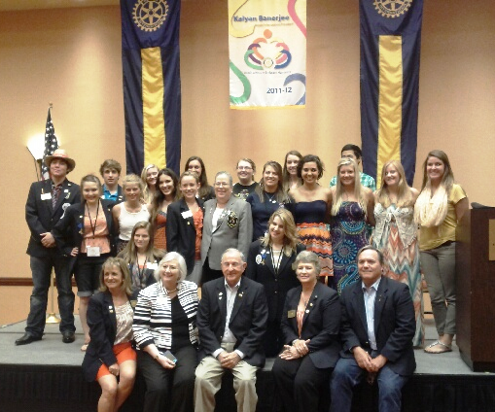
Students and Committee Members at 2012 DistrictFest

Slide 35
URLs To Remember
scrye.org - All about Rotary Youth Exchange
cisi-bolduc.com - Youth Exchange Insurance
rotary.org - All about Rotary International
rotary5840.org - Our Rotary District Info
QUESTIONS?

