Slide 1
What’s Up??
Communicating with District Exchange Students
WhatsApp!!
This Photo by Unknown Author is licensed under CC BY-SA

Slide 2
Why use WhatsApp?
Only us “old guys” mostly use email these days……
This Photo by Unknown Author is licensed under CC BY-SA

Slide 3
Why Districts use WhatsApp?
*Most students have
*Quick communication
*It’s FREE!—to download & use…
(must be in WiFi)

Slide 4
Use WhatsApp for--
*Quick Wellness Checks
*Emergency Communications
*Touching base as needed
(Message and Voice)

Slide 5
Students KNOW when they see a WhatsApp message coming from our District Group that they are to respond IMMEDIATELY!
We do NOT use our District Group as a “social” group—it’s for “business” only.

Slide 6
WhatsApp Features
*International Messaging (Chats)
*International Voice & Video calls
FREE!

Slide 7
How WhatsApp Works
*Uses WiFi not carriers
*All parties must have WhatsApp
*No international plan needed

Slide 8
Setting up WhatsApp
Download App & Install
Open
Follow prompts
Allow access to your contacts

Slide 9
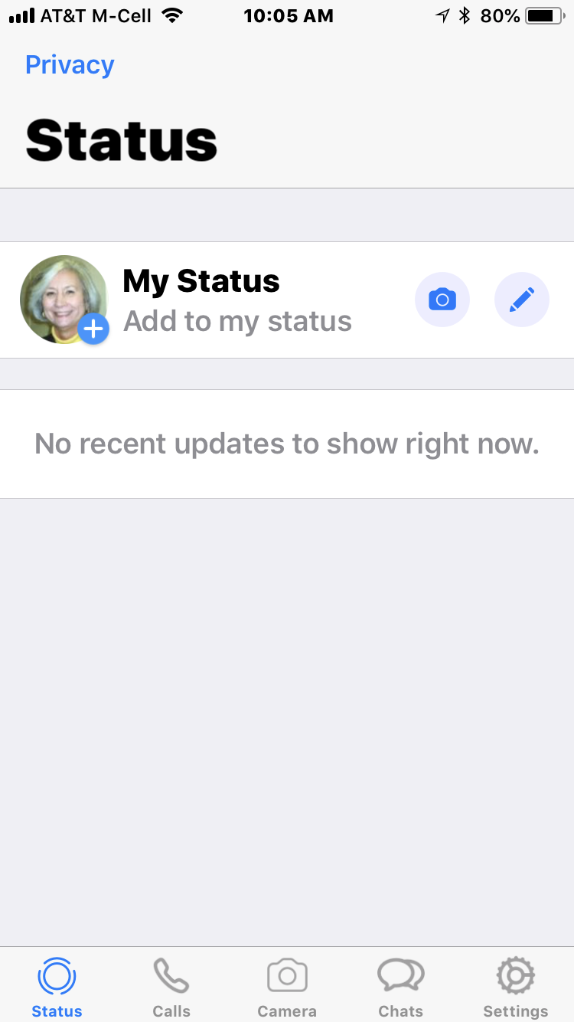
5 General Sections:
*Status
*Calls
*Camera
*Chats
*Settings

Slide 10
Calls
*Tap phone icon
*Your Contact List will appear
(Only contacts using WhatsApp)
*Select voice or video chat

Slide 11
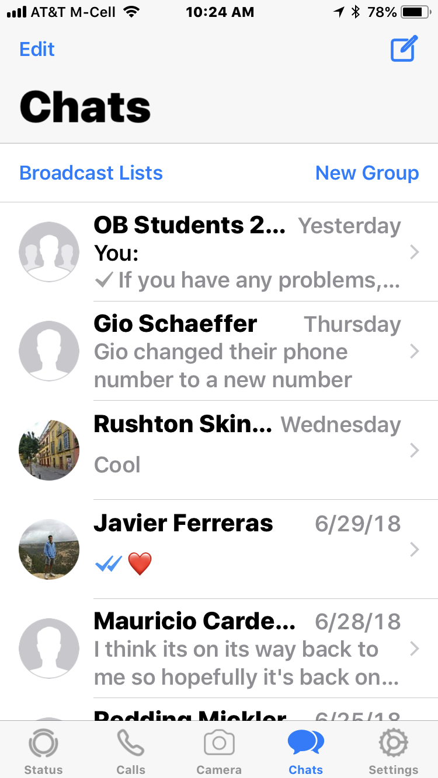
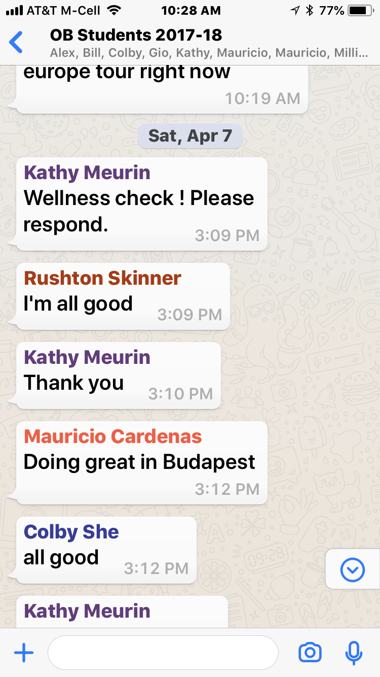
Choose to write message
CHATS
Wellness Check at 3:09
Heard from kids by 3:33
Message bubble

Slide 12
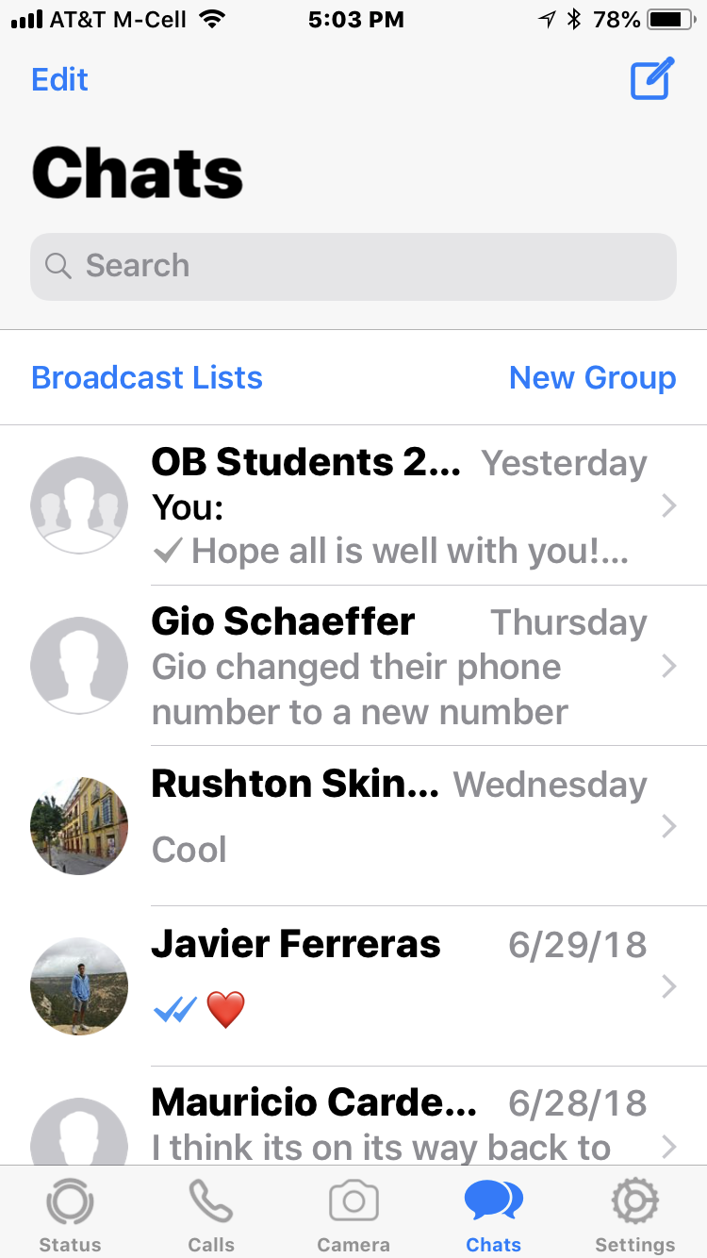
Creating a WhatsApp Group
For iPhone--
Open WhatsApp and Tap “Chats” option
Tap the “New Group” option
Tap a contact’s name to add them to your group
Tap “Next” in the top right corner of your screen
Add a group name
Tap “Create” in the top right corner of your screen
For Android--
Open WhatsApp and Tap “Chats” option
Tap your Android’s menu button
Tap the “New Group” option at the top of the menu
Tap contacts’ names to add them to your group
Add a group name
Tap the checkmark when you are finished

Slide 13
Add Participants—
Choose contacts
Choose Next
Choose Create
Remember—
Participants have to be in or added to your contacts……

Slide 14
How to Invite a Contact to WhatsApp
Inviting a Contact to WhatsApp on iPhone:
Open WhatsApp
Tap Settings
Scroll down and Tap Tell a Friend
Tap Message
Tap your friend’s name
Tap Send 1 invite
Tap the send arrow
Inviting a Contact to WhatsApp on Android:
Open WhatsApp
Tap
Tap Settings
Tap Contacts
Tap Invite a Friend
Tap Messages
Tap your friend’s name
Tap Send 1 invite
Tap the send button

Slide 15
How to Add a Contact on WhatsApp
Adding Contact on an iPhone:
Open WhatsApp; tap Chats tab
Tap the box with the pencil
Tap New Contact
Type in the person’s first name
Tap add phone
Type in your contact’s phone number
Tap Done
Adding Contact on an Android:
Open WhatsApp; tap the speech bubble icon
Tap the person icon with a plus sign
Type in the person’s name
Tap the Phone field
Type in your contact’s phone number
Tap Done

Slide 16
Questions/Discussion

