Slide 1
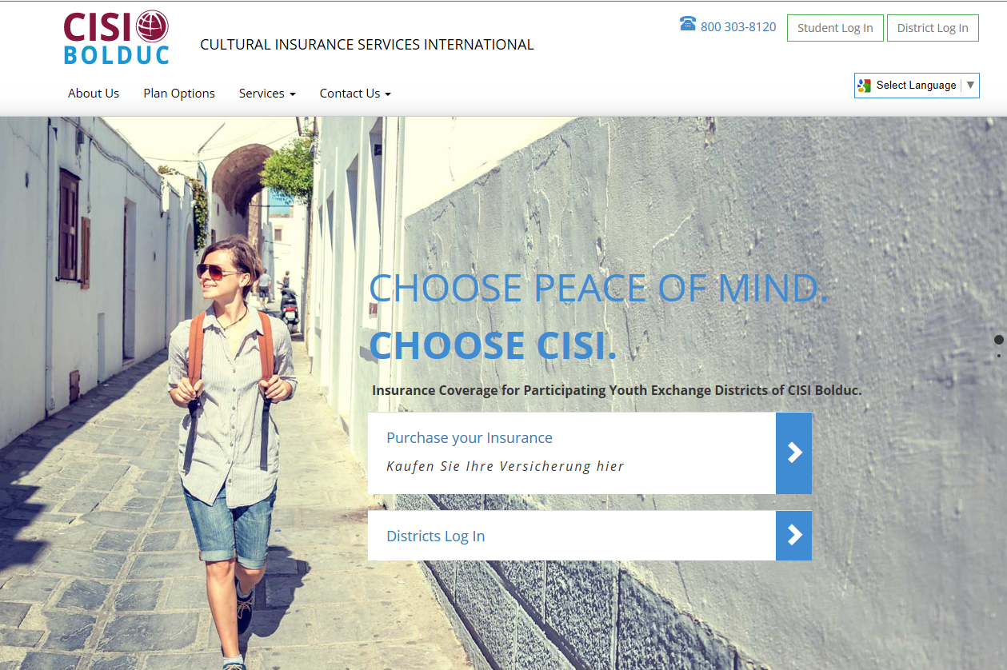

Slide 3
New Benefit for 2017/2018 Exchange Year
Trip Delay up to $500, more than 12 hours, 5 day max
Injury, Sickness or death of the Insured Person;
carrier delay;
lost or stolen passport, travel documents or money;
Quarantine;
Natural Disaster;
the Insured being delayed by a traffic accident while en route to a departure;
hijacking;
unpublished or unannounced strike;
civil disorder or commotion;
riot;
inclement weather which prohibits Common Carrier departure;
a Common Carrier strike or other job action;
equipment failure of a Common Carrier; or
the loss of the Insured's and/or traveling companion's travel documents, tickets or money due to theft.

Slide 4
Medical Expense Benefits
Plan B
INBOUND -Accident & Sickness Limit $1,000,000
One Time deductible of $100
Co-insurance: 80/20 of the first $5,000, thereafter the plan pays at 100%. Out of Pocket Expenses $1,100
OUTBOUND -Accident & Sickness Limit $1,000,000
$0 deductible
100% Coverage
Plan A
Outbound and Inbound - Accident & Sickness Limit $1,000,000
Co-insurance 80/20
$100 Deductible

Slide 5
This policy covers
Accidents; like sprained ankles
Sickness; such as colds and flu
Doctors Visits
Prescriptions
Emergency room visits
Labs, Tests and X-Rays
Inpatient Hospital Stays

Slide 6
Additional Benefits
Mental & Nervous : $1,000 for outpatient, $25,000 inpatient
Emergency Dental up to $400 (relief of pain)
Trip Cancellation up to $3000 (prior to departure)
Maximum benefit for Medical Evacuation- $100,000
Maximum benefit for Repatriation/Return of Mortal Remains- $50,000
Chiropractic paid up to $50 per visit up to $500 (or 10 visits)
Emergency Family Reunion benefit of $5000 for flights, meals and hotel if the insured is hospitalized in excess of 4 days and a family member travels to bedside.
Round trip flight benefit of $3000 if the insured must return home due to the death or serious illness of grandparent, parent or sibling.
Security Evacuation benefit up to $100,000 for unrest and natural disasters

Slide 7
Primary Exclusions
This is what CISI unfortunately cannot cover:
Routine Physicals and Immunizations
Along with Sports Physicals
Routine Dental Care
Vision exams, eye glasses and contact lenses

Slide 8
AXA Assistance is available for you around the clock! Anyone can open a case on
behalf of the insured if there is an emergency.
Legal Assistance-
lets say you are arrested and need a lawyer, TA will provide you with a lawyer and help you
through the process
Medical evacuation-
If you need to be relocated to another hospital or to a hospital back home. TA will help you
with this process
Multi-lingual services are available-
TA has staff members that are fluent in other languages to assist you while you are abroad
Assistance in replacing passports -
TA will coordinate with the consulate to provide you with a new passport
Assistance with Prescription drug -
shipment/replacement-TA will coordinate with a pharmacy to replace your medication
(if the drug can not be found abroad)

Slide 9
Assistance Team
How to contact AXA Assistance:
AXA can be accessed 24/7/365 days year.
Within the U.S. : 1-855-327-1411
Internationally: 1-312-935-1703
Email: Medassist-usa@axa-assistance.us

Slide 10
CISI Crisis Team
The CISI Crisis Team consists of seasoned staff who are actively involved in Emergency Assistance Cases.
They are notified at the onset of every case and kept informed throughout the life of the case to ensure that appropriate actions are being taken.
The Crisis Team has 4 members:
Shannon McNamara- Health and Safety Manager
Christine Wasil- Director of Operations
Ellen Vetrano- Claim Operations Manager
Sheila Lorson- Benefit Analyst
Drew Woods-Benefit Analyst
CISI’s Crisis Team allows clients access to a familiar voice, support and guaranteed action during a time of crisis.
+203-550-9028 or crisis@culturalinsurance.com

Slide 11
In Case of a Minor Injury or Illness
We are always happy to pay a provider directly, however if you pay upfront:
Outbound- no Network
Inbound-
Hold onto your medial bills
Complete the medical claim from
Submit to CISI for reimbursement

Slide 12
In Case of a Serious Injury or Illness
For all emergencies, seek help without delay at the nearest facility and then, after admittance, open up a case with Team Assist (our 24/7 assistance provider).
Contact AXA Assistance to open a medical case
Provide AXA the location and the students information
AXA will contact the facility to issue a guarantee of payment
Email AXA at medassist-usa@axa-assistance.us
AXA Collect +1-312-935-1703

Slide 13
Student Portal Welcome Screen

Slide 16
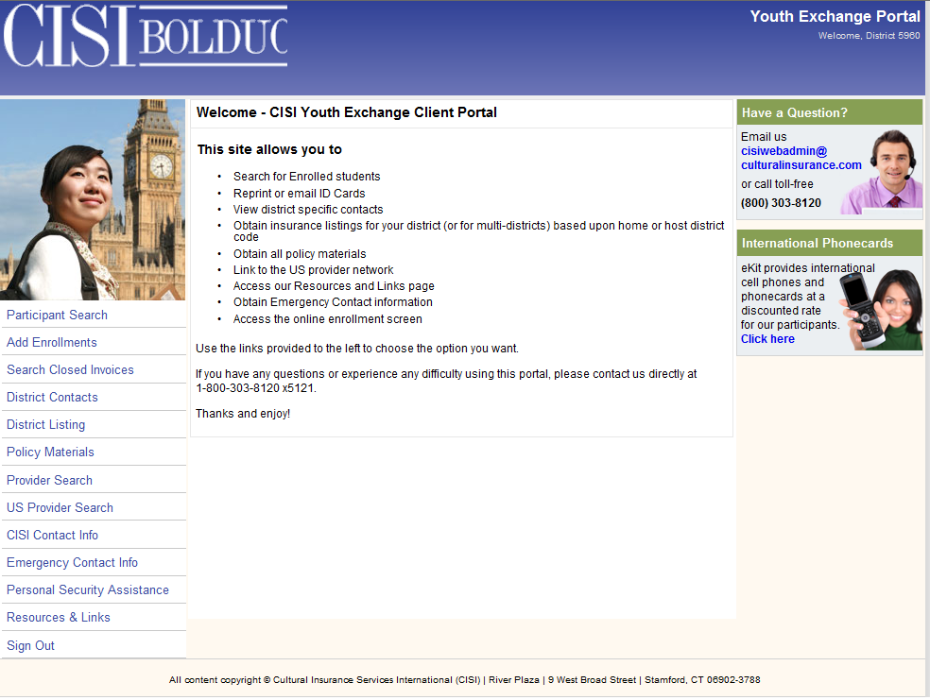

Slide 18
2017 Rates
Outbound
Plan B $839
Plan A $567
Plan B $76 (Short Term)
Inbound to the USA
Plan B $1099
Plan A $1046
Plan B $86 (Short Term)

Slide 19
Questions?
Please contact Ted Cenatiempo
Office 203-399-5556
Email: tcenatiempo@culturalinsurance.com
Visit www.CISI-Bolduc.com for:
Insurance Applications in various languages
Claim forms
Emergency contact information
And much more

