Slide 1
PRE-CRISIS PLANNING
SCRYE WINTER CONFERENCE
TULSA, OK, USA
January 23, 2016

Slide 2
PRE-CRISIS PLANNING
Don Peters
D-6150
Arkansas
rye6150@gmail.com

Slide 3
PRE-CRISIS PLANNING
When Mother Nature Lets Loose:
Preparing for a Natural Disaster and Its Aftermath

Slide 4
PRE-CRISIS PLANNING
This session will build on the training we have done about pre crisis management and focus on the unique aspects of dealing with a
natural disaster.

Slide 5
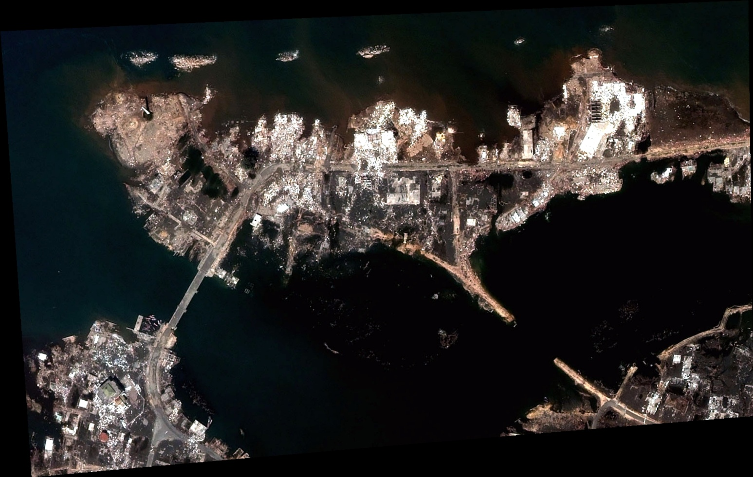
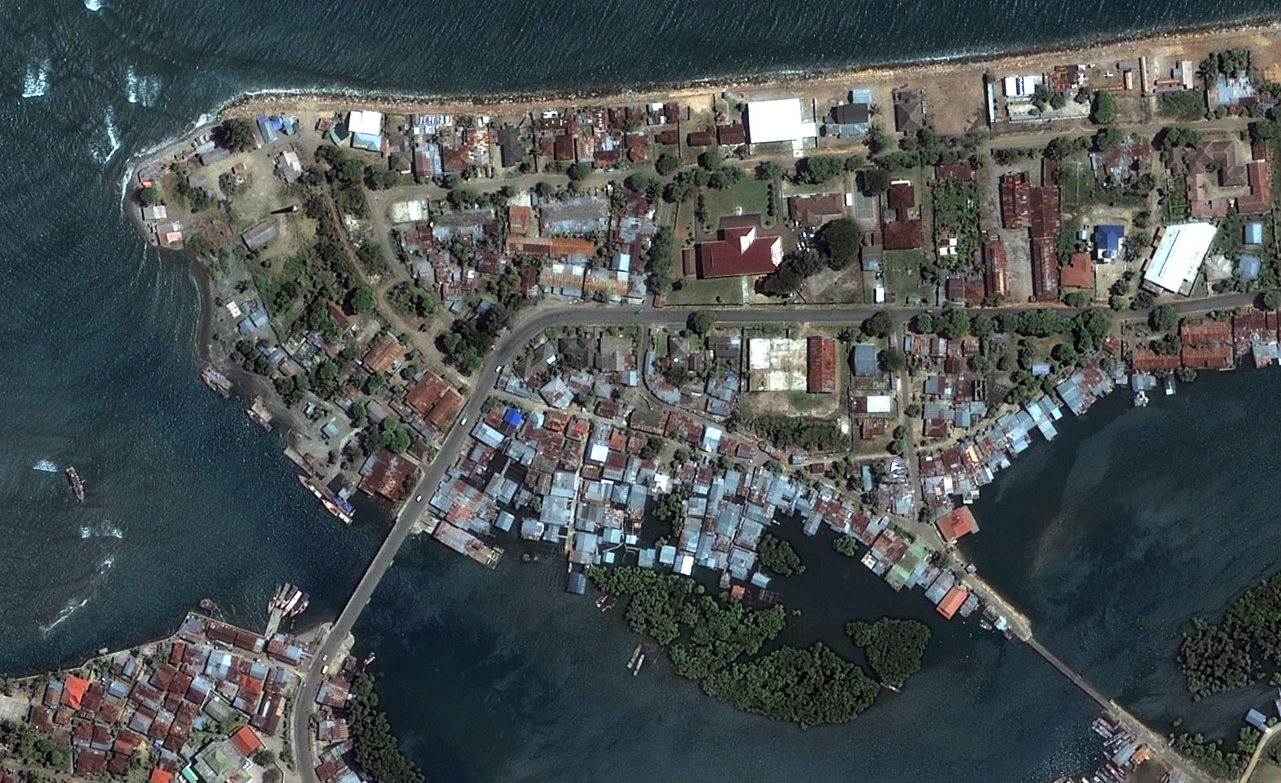
PRE-CRISIS PLANNING – Natural Disaster
T
S
U
N
A
M
I

Slide 6
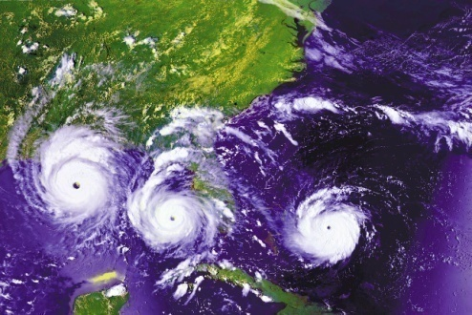
PRE-CRISIS PLANNING – Natural Disaster
H
U
R
R
I
C
A
N
E

Slide 7
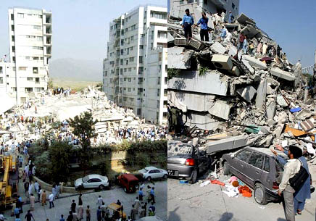
PRE-CRISIS PLANNING – Natural Disaster
E A R T H Q U A K E

Slide 8
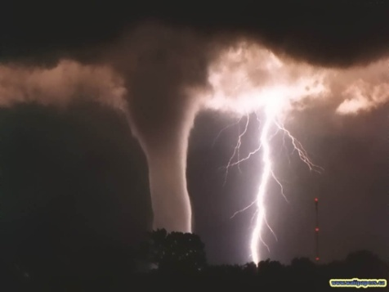
PRE-CRISIS PLANNING – Natural Disaster
T O R N A D O

Slide 9
PRE-CRISIS PLANNING – Natural Disaster
V O L C A N O

Slide 10
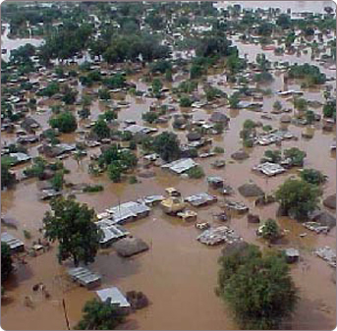
PRE-CRISIS PLANNING – Natural Disaster
FLOOD

Slide 11
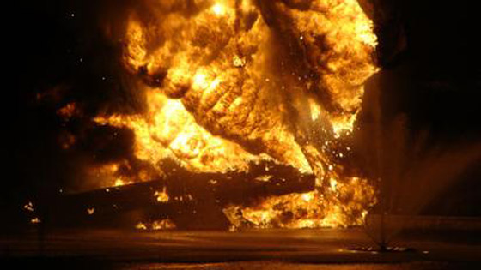
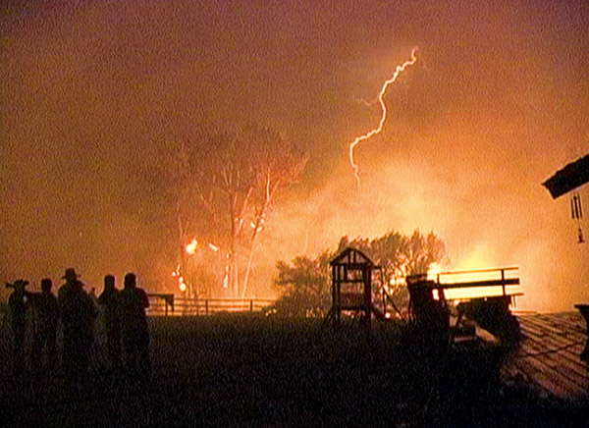
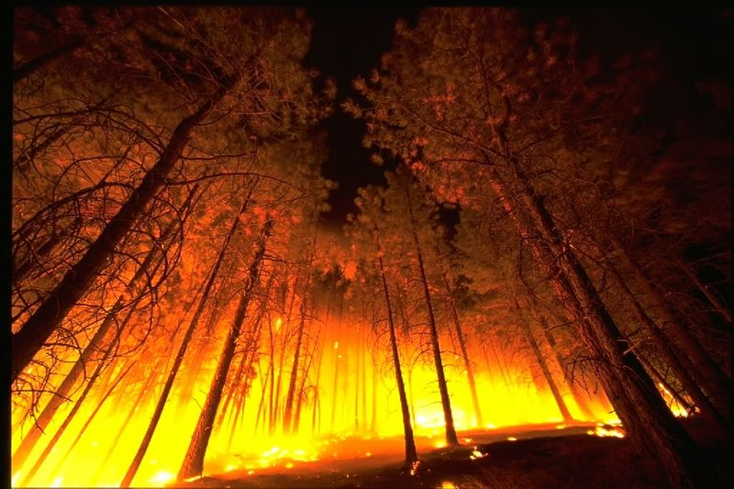
PRE-CRISIS PLANNING – Natural Disaster
L
I
G B
H O
T L
N T
I
N
G

Slide 12
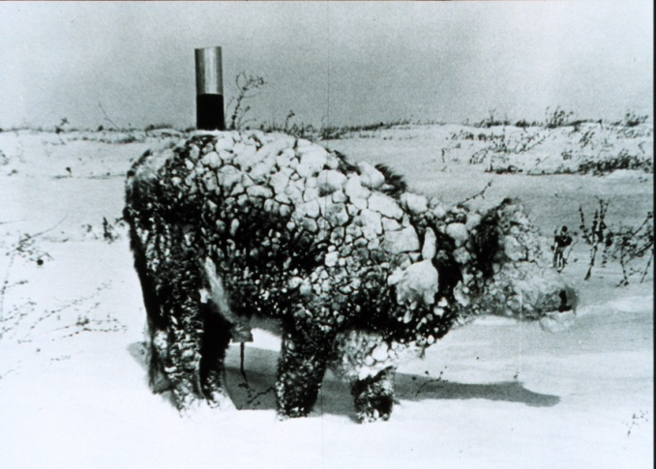
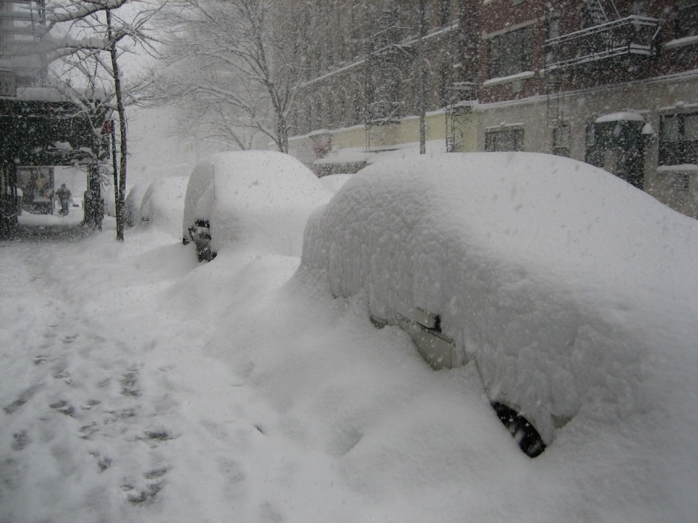
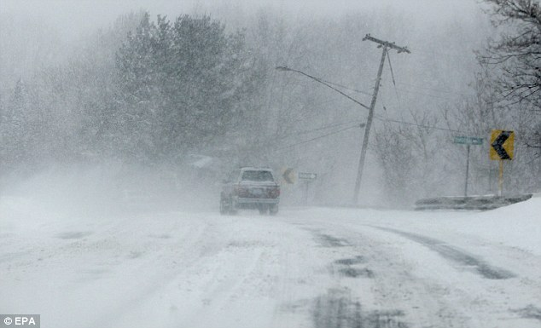
PRE-CRISIS PLANNING – Natural Disaster
S
N
O
W
S
T
O
R
M
Floods

Slide 13
District Crisis Plan Template - Structure
Overview
District Crisis Management Team
Emergency Preparedness
Procedures
Inbound Student
Outbound Student
Appendices
Emergency Contacts
Inbound Crisis
Summary
Incident Report
Log of Contacts
Sample Press Release
Ten Positive Points
Outbound Crisis
Summary
Incident Report
RI Guidelines for Youth Exchange Emergencies
Resources

Slide 14
District Crisis Plan Template
Overview
Safety of student(s) is first priority
Can involve
inbounds or outbounds
Single student or group of students from multiple districts
TIMELY/ACCURATE/CONCISE information
IMMEDIATE response is needed
Maintain log of all contacts

Slide 15
District Crisis Plan Template
District Crisis Management Team
Chair
Vice Chair
District Youth Exchange Officer
District Governor
Media Representative
Crisis Counselor
Club YEOs, as appropriate

Slide 16
District Crisis Plan Template
Emergency
Preparedness

Slide 17
Emergency Preparedness
Steps
Crisis Identification
Identification of Vulnerabilities
Available Resources
Emergency Contact Cards
Response Procedures

Slide 18
Emergency Preparedness
Crisis Identification
Natural Disasters
Based on prior experiences
Examples => Hurricanes, Earthquakes, Heavy Snow/Rain
Other Disasters
Examples => Fire, Abuse, Rape, Surgery, Death

Slide 19
Emergency Preparedness
Identification of Vulnerabilities
Natural Disasters
May be specific to certain areas of District
Other Disasters
Common risk to all of District
Design Crisis Management Plan based on possible disasters in area of district
=> Have plans for different areas of
District

Slide 20
Emergency Preparedness
Available Resources
Virtual Single Point of Contact
Toll free number
Available 24 hours, 7 days per week
Person answers phone and stays with the caller until call is transferred to appropriate person in Rotary District

Slide 21
Emergency Preparedness
Available Resources
External Resources
Civil Defense/FEMA regarding natural disasters
Convey recommended actions to students
District Crisis Management Team
List of students with contact information
Maintain inventory of critical items
First Aid Kits
Food and Water
Fuel
Backup Generators

Slide 22
Emergency Preparedness
Available Resources
Rotary International
Media Crisis Handbook (515-EN, free)
Youth Exchange Staff – Kate Hoeppel
(847-866-3422, youthexchange@rotary.org)
Public Relations Department

Slide 23
Emergency Preparedness
Emergency Contact Card
Presented at Orientation
Toll Free Emergency Number
Host Rotary District
US -> Department of State (866-283-9090)
Add to Currently Required Contact Information for Student ID Card

Slide 24
Emergency Preparedness
Emergency Contact Card - Students
Presented on or before arrival
Rotary Chain of Command
Name, Cell Phone Number, Email Address
Toll Free Emergency Number
Rotary District
US -> Department of State (866-283-9090)
Host Parents | 4. District YEO
2. Rotary Counselor | 5. District Governor
3. Rotary Club President | 6. Non-Rotarian Resource

Slide 25
Emergency Preparedness
Emergency Contact Card – Host Family
Presented at Orientation
Rotary Chain of Command
Name, Cell Phone Number, Email Address
Toll Free Emergency Number
Rotary District
US -> Department of State (866-283-9090)
Rotary Contact (Counselor, YEO) | 4. District YEO
2. Rotary Club President | 5. District Governor
3. District YE Inbound Chair

Slide 26
Emergency Preparedness
Emergency Contact Card - Rotarians
Crisis Management Team Members
Name, Cell Phone Number, Email Address
Toll Free Emergency Number
Rotary District
US -> Department of State (866-283-9090)
Chair | Vice Chair
District YEO | District Governor
Media Representative | Crisis Counselor

Slide 27
District Crisis Plan Template
Inbound Crisis
Procedure Summary

Slide 28
District Crisis Plan Template - Inbound
Information Needed by Crisis Team
Contact information of Rotarian
For each student involved
Name
Host club
Home country
Sponsoring district
Current location
Nature of crisis and any details available
Name, phone numbers of officials

Slide 29
District Crisis Plan Template - Inbound
Release of Information
Authorized Information for Release Approved by:
Natural Parents
Authorities
Host Parents, if needed
Information Internal to Crisis Team
All information subject to authorities
First Amendment
Recognized subject to:
Privacy rights
Restrictions by authorities

Slide 30
District Crisis Plan Template - Inbound
Chair Responsibilities
Complete Initial Incident Report
Confirm facts of crisis with authorities
Finalize Incident Report and distribute to Team
Overall management of crisis response

Slide 31
District Crisis Plan Template - Inbound
District YEO Responsibilities
Identify interpreter and use as needed
Obtain natural parents wishes working with sponsoring district YEO
Provide Available Information to:
Department of State – Host Clubs
CSIET, if applicable – Host Families
RI Youth Exchange – Inbound Students
Embassy/Consulate

Slide 32
District Crisis Plan Template - Inbound
District Governor Responsibilities
Use interpreter as needed
Provide Available Information to Sponsor District Governor
Obtain Talking Points from Media Representative

Slide 33
District Crisis Plan Template - Inbound
Media Representative Responsibilities
Provide Talking Points to Crisis Management Team
Serve as Sole Media Contact for Host Club and District
Provide Available Information to
Media
District/Club Webmasters for
updates on social media

Slide 34
District Crisis Plan Template - Inbound
Vice Chair Responsibilities
Provide Available Information to:
Insurance Company
RI Risk Management
Non-hosting Clubs in District
Host Schools
Interface with Funeral Home, as needed
Arrange Bank Account for Contribution
Fund, as needed

Slide 35
District Crisis Plan Template - Inbound
Crisis Counselor Responsibilities
Provide Counseling as needed to:
Host Rotary Club
Host Families
Inbound Students

Slide 36
District Crisis Plan Template
Outbound Crisis
Procedure Summary

Slide 37
District Crisis Plan Template - Outbound
Information Needed by Crisis Team
For each student involved
Name
Host country
Host district
Host club
Current location
Nature of crisis and any details available

Slide 38
District Crisis Plan Template - Outbound
Release of Information
Authorized Information for Release Approved by:
Natural Parents
Authorities
Information Internal to Crisis Team
All information subject to authorities
First Amendment
Recognized subject to:
Privacy rights
Restrictions by authorities

Slide 39
District Crisis Plan Template - Outbound
Chair Responsibilities
Complete Initial Incident Report
Obtain confirmation of facts from District YEO
Finalize Incident Report and distribute to Team
Overall management of crisis response

Slide 40
District Crisis Plan Template - Outbound
District YEO Responsibilities
Identify interpreter and use as needed
Confirm facts of crisis with Host District YEO
Obtain natural parents wishes working with sponsoring Rotary club
Provide Available Information to:
RI Youth Exchange
Embassy/Consulate
Sponsor Clubs
Outbound Students

Slide 41
District Crisis Plan Template - Outbound
District Governor Responsibilities
Use interpreter as needed
Maintain Interface with Host District Governor
Obtain Talking Points from Media Representative

Slide 42
District Crisis Plan Template - Outbound
Media Representative Responsibilities
Provide Talking Points to Crisis Management Team
Serve as Sole Media Contact for Sponsor Club and District
Provide Available Information to
Media
District/Club Webmasters for
updates on social media

Slide 43
District Crisis Plan Template - Outbound
Vice Chair Responsibilities
Provide Available Information to:
Insurance Company
RI Risk Management
Non-sponsoring Clubs in District
Sponsor Schools
Interface with Funeral Home, as needed
Arrange Bank Account for Contribution
Fund, as needed

Slide 44
District Crisis Plan Template - Outbound
Crisis Counselor Responsibilities
Provide Counseling as needed to:
Sponsor Rotary Club
Natural Families
Outbound Students

Slide 45
District Crisis Plan Template
Appendices
List of Emergency Contacts
Inbound Crisis Procedure Summary
Inbound Crisis Procedure Incident Report
Crisis Procedure Log of Contacts
Sample Press Release
Ten Positive Points
Outbound Crisis Procedure Summary
Outbound Crisis Procedure Incident Report
RI Guidelines for Youth Exchange Emergencies
Resources
45

Slide 46
District Crisis Plan
Comments?
Questions?

Slide 47
District Crisis Plan

